Slide 1


Wednesday October 26, 2026
Parenting
and Challenging Behaviours
A. Ianto West, Psy.D.

Slide 2
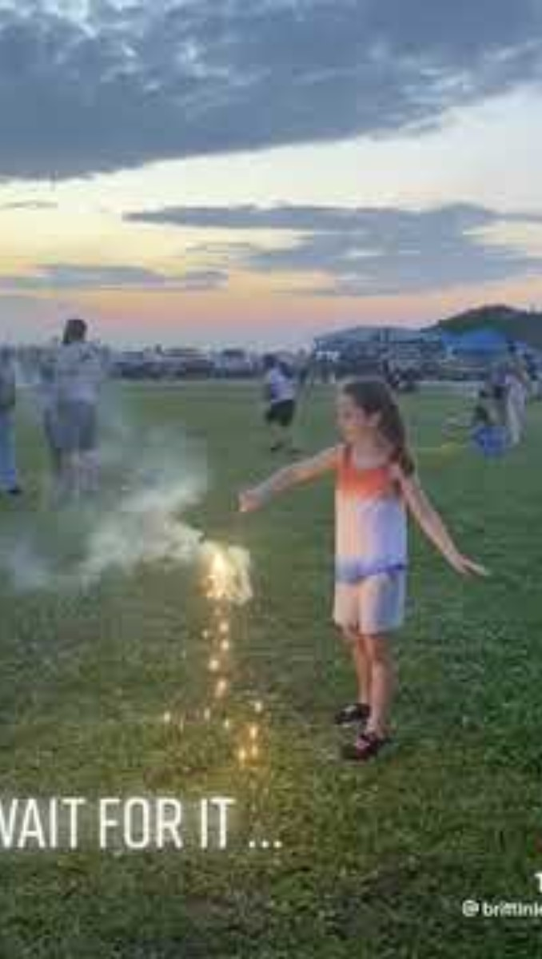
Fire Poker
…
Notes:
Picture this, you’ve just found an actually nice group of parent friends. You got invited to their kid’s birthday party.
You arrive late because that’s how it goes. Everyone else’s kids are sitting down together in the living room, playing quietly. The moment you sit down you blink (rookie mistake) and see your kid is already clear across the house, pulling out the fire poker.
Parenting is great. It can also be a lot. And for some of us, it’s a LOT a LOT.
Media: https://youtube.com/shorts/XDgsZIvfngE?si=cw680swvbJfDEQc0

Slide 3

All Kids Learn

Slide 4
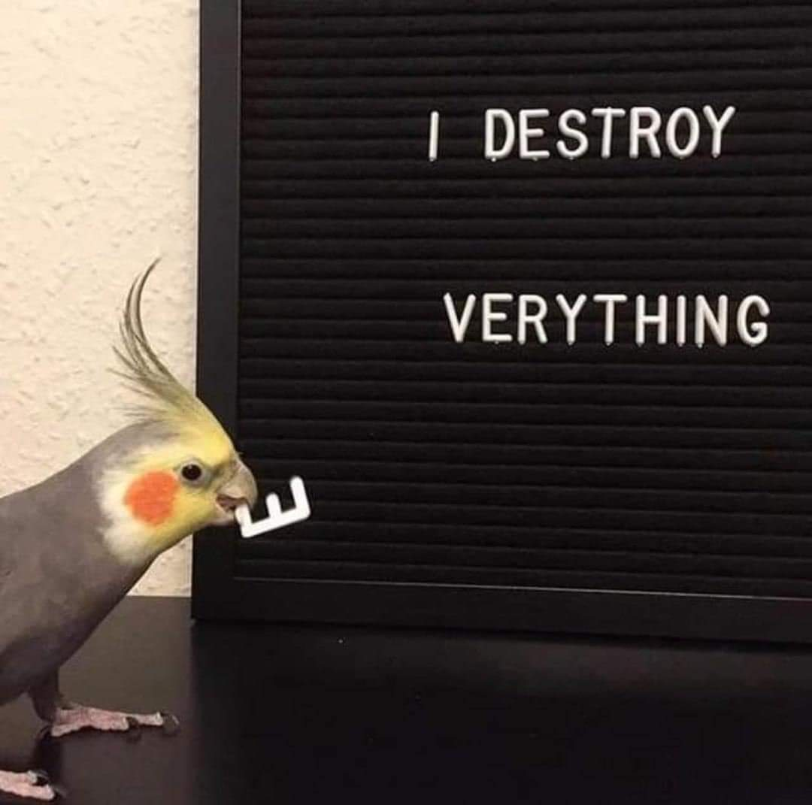
… But sometimes they learn things we might wish they wouldn’t
Notes:
Image credit: https://share.google/images/JLiW5F05eZ8hWnSFw

Slide 5
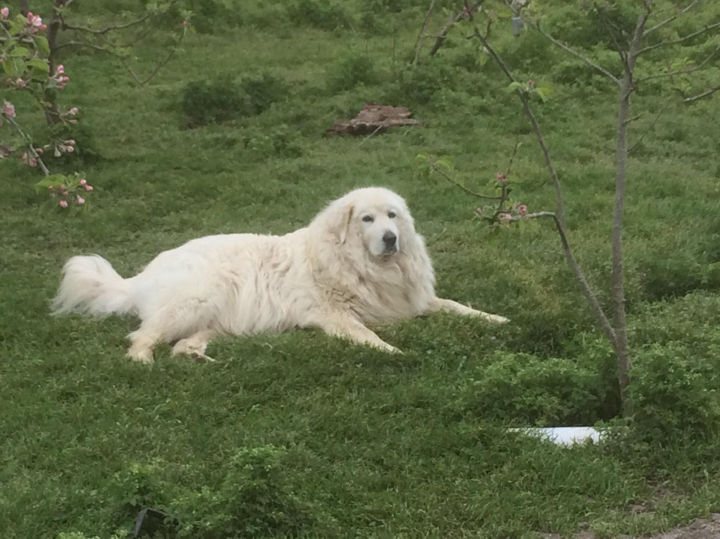
Learning Objectives
Explain why ADHD can make behaviour more challenging
Identify some strategies to reduce stress and improve behaviour
Locate resources for ongoing support
Notes:
Image credit https://share.google/images/lYmq3M20R9Bpf4WpT

Slide 6
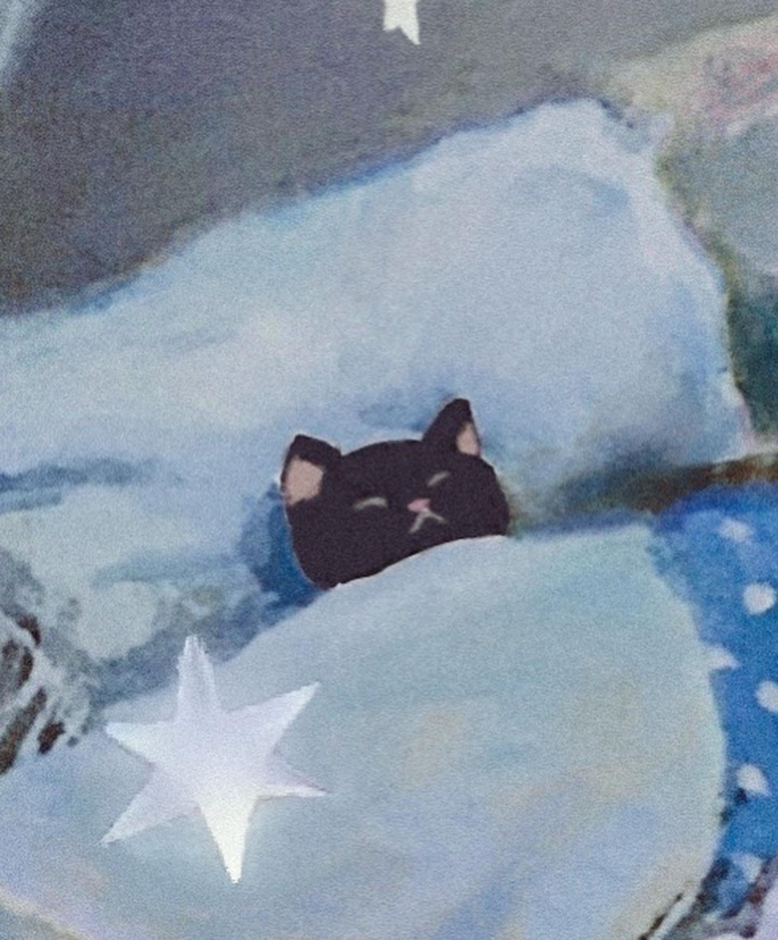
(Realistic) Learning Objective
Real talk – parenting can be HARD
What do I really hope you will get from today?
In that twilight between the kid going to bed and you going to bed, look back on how the day went.
Be able to prepare one thing to help things go a little better in the future
Notes:
Image credit https://share.google/images/L3sva0TBbaPhhF508

Slide 7

Why do they do these things?

Slide 8

Why do they do these things?
Children’s natural daily experiences can set them up to learn some difficult behaviours
Examples:
  grocery store check out
  Classmates laugh at a swear
  Lying about homework or grades works sometimes
Notes:
Image credit https://share.google/images/gU1MxztExztAWmEn5
Grocery shopping is hard and exhausting. You’ve probably already said “no” exactly a million times. And then you get to the check out and there’s candy, lots of it. And they whine, and whine, and WHINE, and you give in this one time. You’re not an evil mastermind, you probably want your child to enjoy their life, and you SURE could use the break from the whining. The problem? That possible sometimes is really exciting (it’s why people gamble after all). And when it comes after them pushing, it rewards them pushing. It shows them pushing works sometimes.
Rewards are a big part of why we do things. Would you keep doing your job if your paycheck stopped?
There’s probably been a time where your child used a curse word for the first time and it was hilarious. They accidentally had good timing, or pronounced it silly, or it was just so surprising that you laughed. And then welcome to the next 6 weeks of them repeating that word every 20 minutes, definitely in front of every other adult you respect.
Grades only happen a few times a year. For a kid who is already struggling in school, what this can look like is “I get yelled at for bad grades or for lying, but there’s a chance I get away with it.” It’s not that they are always doing conscious math about these behaviours, sometimes it’s just the path of least resistance.

Slide 9
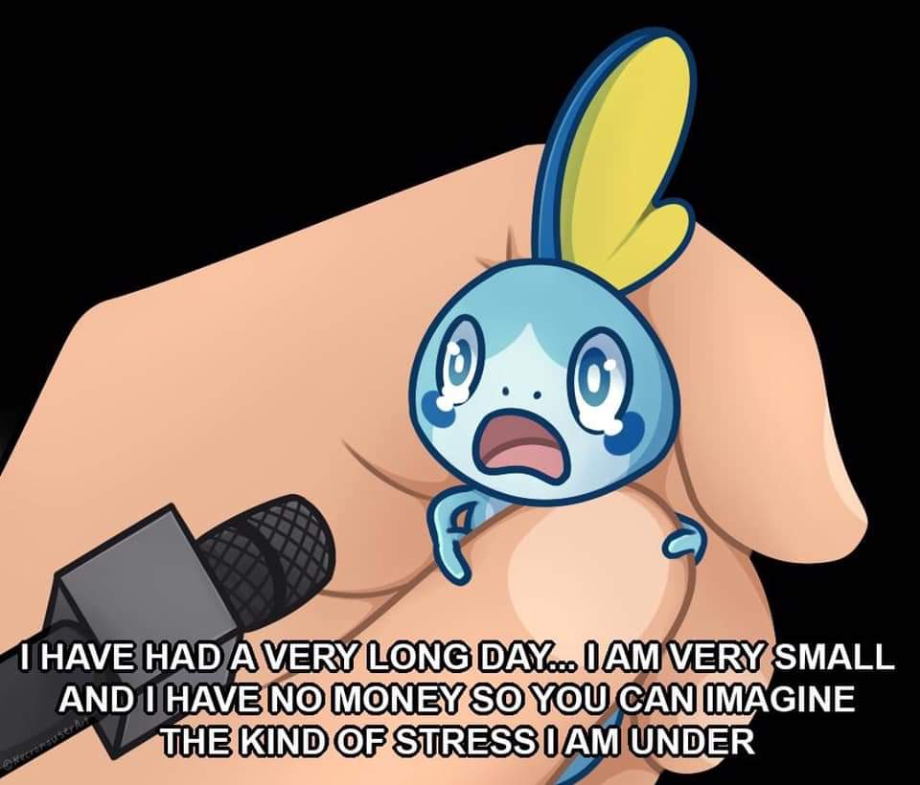
And with ADHD…
Learned behaviour problems happen with all kids
ADHD can also accelerate the problem:
May appear more driven, persistent, or willful about getting certain rewards
May be harder to tolerate correction, or a withheld reward
May take longer to learn preferred behaviours
Once they learn a positive behaviour, they may still make a lot of mistakes
Notes:
Image credit: https://share.google/images/NxuHochvCSGzwJSCO

Slide 10
What can we do?

Slide 11
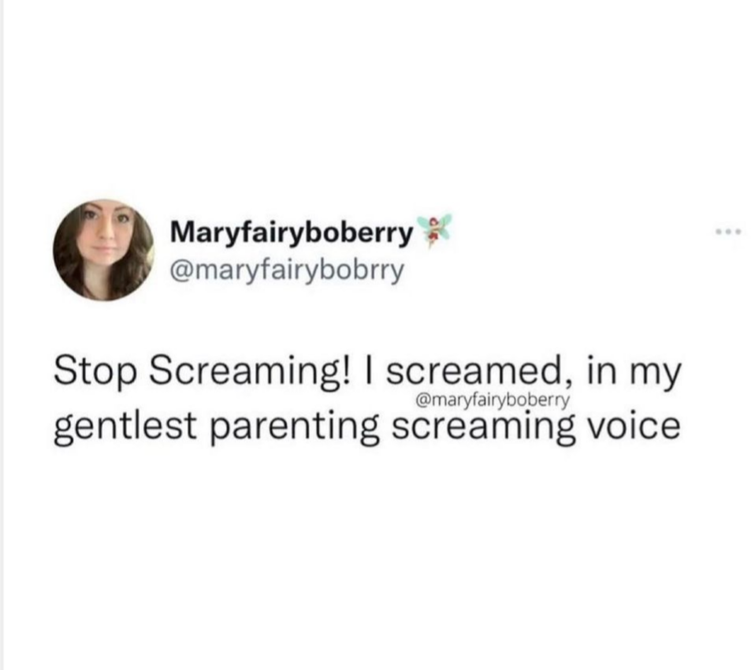
Notes:
Image credit https://share.google/images/AVvRjOAqoFA1ZA3A2

Slide 12
Be More Proactive
(less reactive)

Slide 13
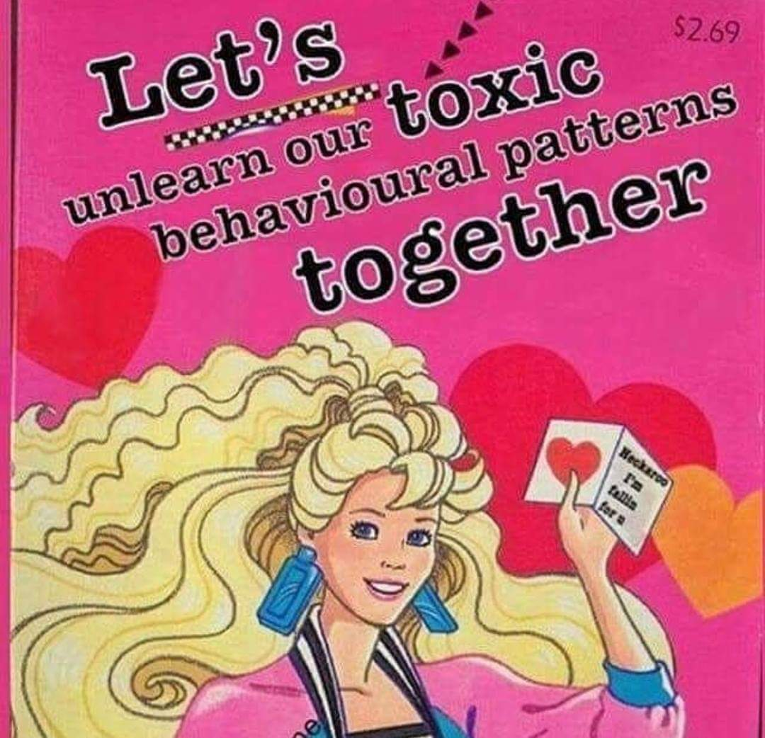
Notes:
Image credit https://share.google/images/gNfr8f6kX0ei9k06x

Slide 14
Core ADHD Behavioral Strategies
There are MANY established evidence based behavioural strategies that work. These have been around for decades.
We could spend weeks talking about these techniques.
Many of these strategies only work if you fully commit to them. (So better to start when you feel ready).
Today, I want to focus more on the art of realistically putting these thigs into practice.

Slide 15
Core ADHD Behavioral Strategies
Save your breath
Grass is greener where you water it
SMART goals

Slide 16
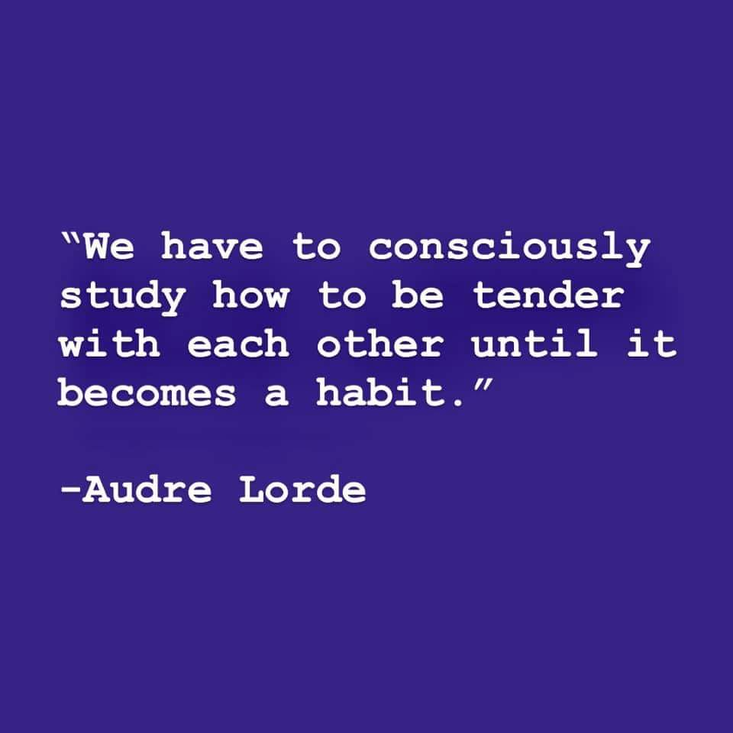
1. Save Your Breath
Experience: “They only listen when I shout”
What’s behind that?
ADHD might mean they did not hear you
If you only follow through when you’re shouting, children learn to ignore everything before the shout
Notes:
Image credit https://share.google/images/GFKr7OJl7X0dQyKsN

Slide 17
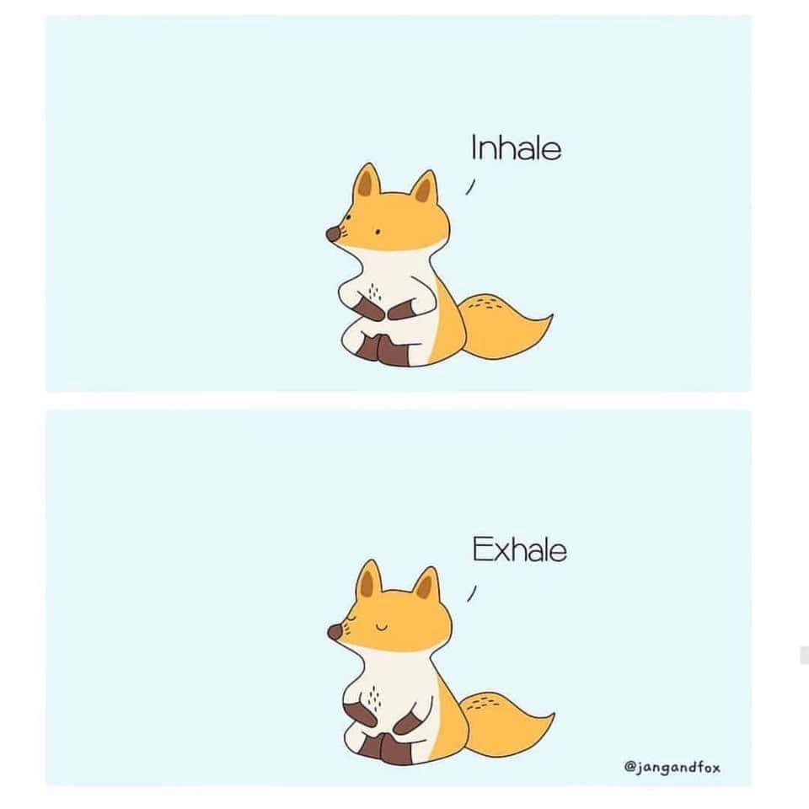
1. Save Your Breath
What to try instead:
Before you tell them something, take a breath
Go towards them
Gently get their attention (ex: by touching their hand or shoulder)
Look them in the eyes
Now tell them
Notes:
Image credit https://mymodernmet.com/wp/wp-content/uploads/2019/06/animal-comics-jangandfox-3.jpg

Slide 18
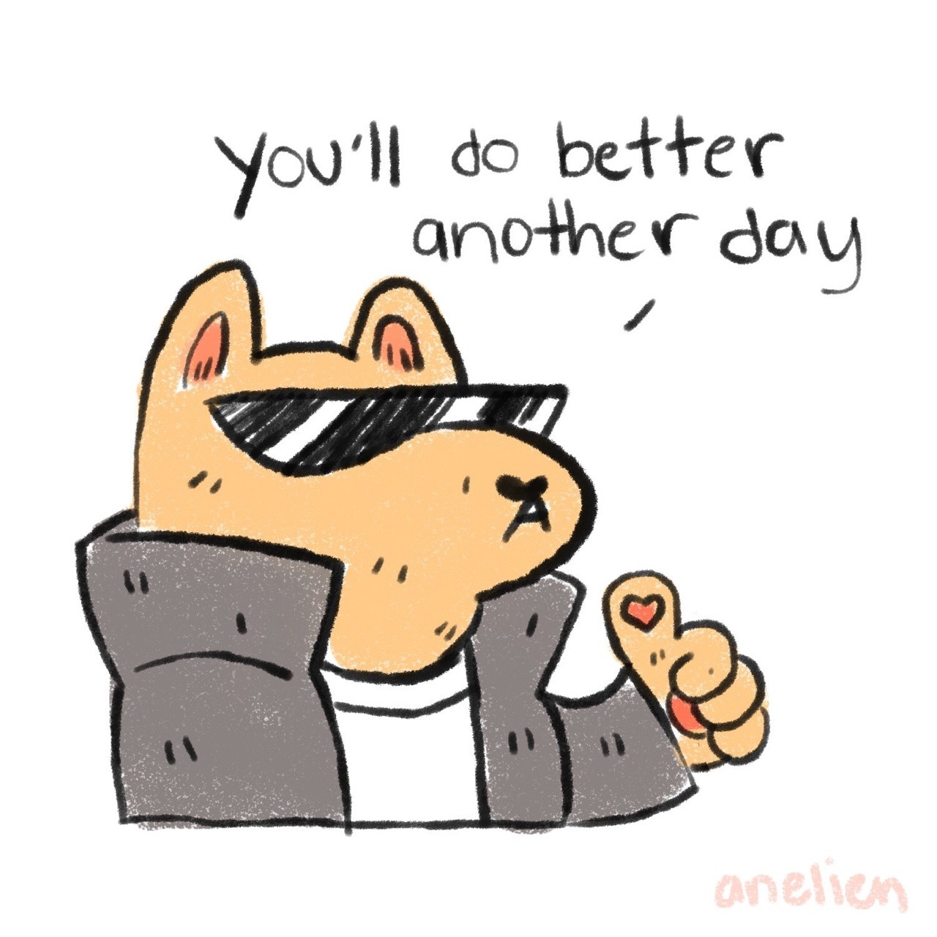
1. Save Your Breath
What to try instead:
Use statements instead of questions when something is mandatory
Example:
Instead of “Can you get dressed please, we’re going to be late for the doctor!?!?!”
Try “Time for shoes” (hand them the shoes)
This helps minimize resistance.
Notes:
Image credit https://x.com/WholesomeMeme/status/1968306641285042622
Does phrasing this way work like magic? Yes and no.
Sometimes your child genuinely does not want to do the thing. Sometimes the skill or transition might be too hard.
Long story short, if this doesn’t work don’t despair – there’s other things you can try.
This technique MINIMIZES resistance; it doesn’t necessarily eliminate it.

Slide 19
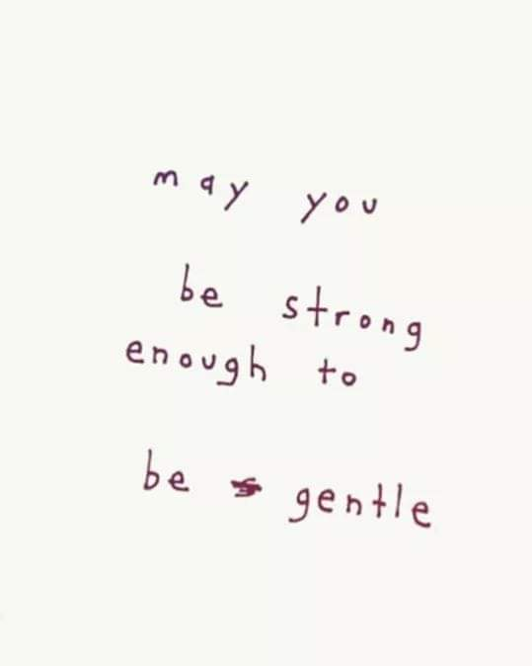
1. Save Your Breath
Only set limits you can enforce.
Let the rest go
Or influence it slower, indirectly (more on this later)
Example:
Instead of “STOP MAKING THAT NOISE, YOU’RE GOING TO MAKE ME CRASH THE CAR”
Try “It’s loud in here. Car drives once it’s quiet.”
Notes:
Image credit https://share.google/images/ox67kCDbtYvjnWSJd

Slide 20
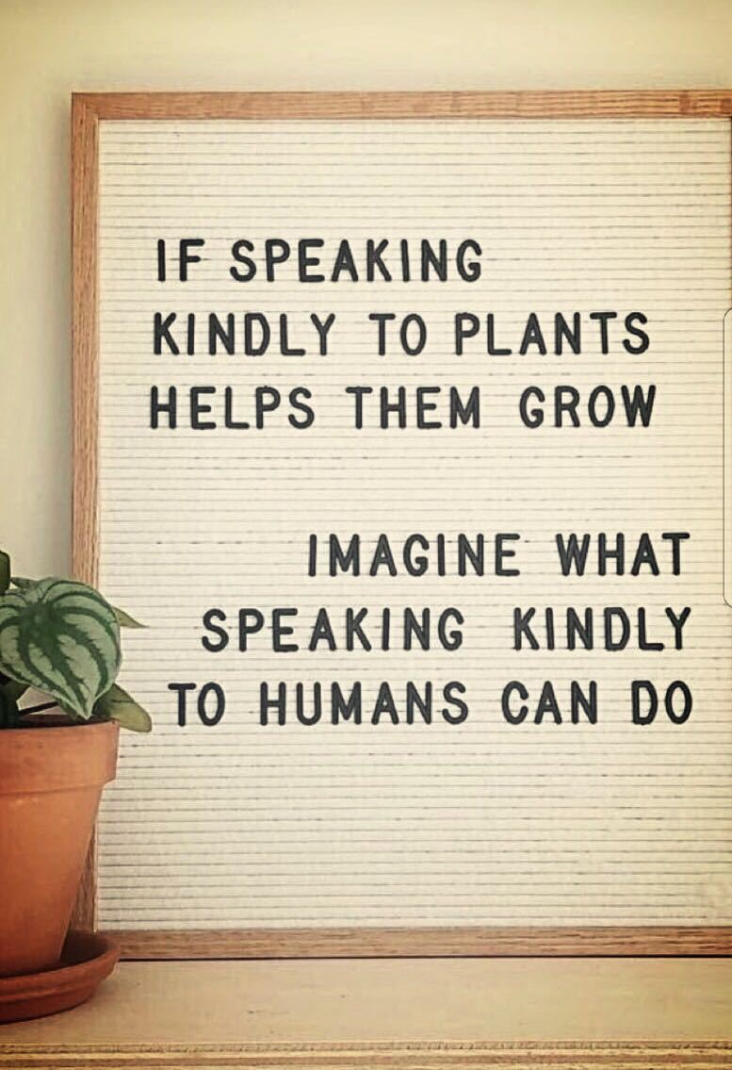
2. Grass is greener (where you water it)
Kids with ADHD get a LOT of negative criticism. This has consequences.
Would you keep listening to someone who only complains about you?
You can nudge them towards listening more if you make listening to you rewarding.
Notes:
Image credit https://www.theuplifterspodcast.com/p/kindness-is-a-verb?utm_campaign=post&utm_medium=web

Slide 21
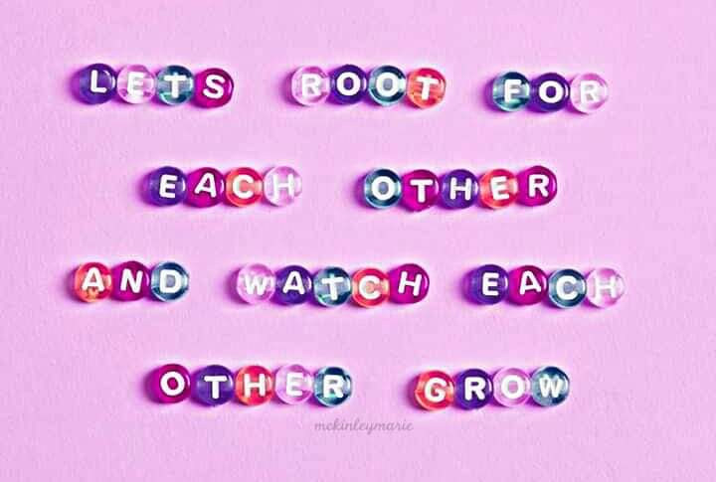
2. Grass is greener (where you water it)
Try:
Make a tally of how many corrections, reminders, complaints etc. you make compared to positive comments in a morning
(Most of us give way more corrections than praise)
Aim towards 4 positive interactions for every 1 correction no matter how “good” they are being
Aiming for 4 to 1 positive to negative
Notes:
Image credit https://share.google/images/PmV29hJxZfr4nvkWk
I think the real trick of this approach is to do this when they are behaving at their absolute worst.
(and, yes, that’s when it is the hardest to do)

Slide 22
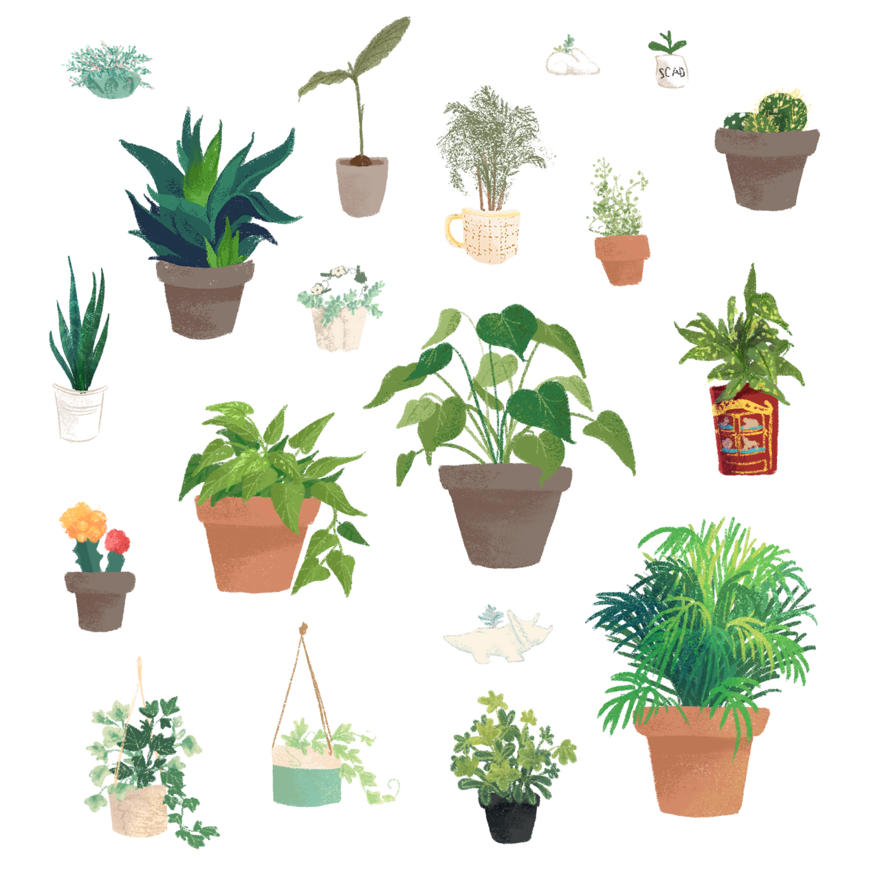
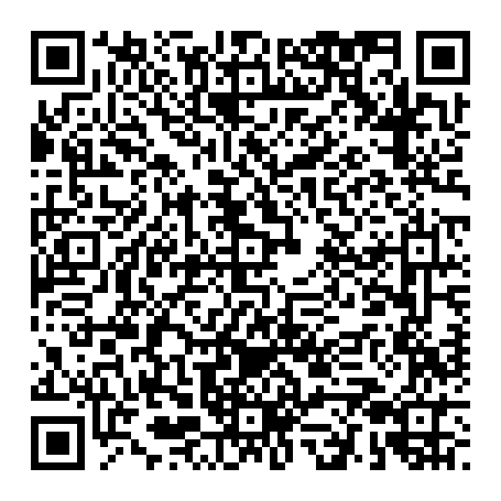
2. Grass is greener (where you water it)
Sometimes it can be HARD to find the good things to praise. Building in more positive activities can help shift things.
Play is a great way to build connection and improve listening!
When was the last time you had genuine fun together? Were silly together? Without distractions? What could you do every day?
5 min Daily Special Playtime
Notes:
Image credit https://share.google/images/PmV29hJxZfr4nvkWk
The 5-minute daily playtime ritual that can get your kids to listen better : Life Kit : NPR
https://www.npr.org/2022/10/13/1128737199/the-5-minute-daily-playtime-ritual-that-can-get-your-kids-to-listen-better

Slide 23
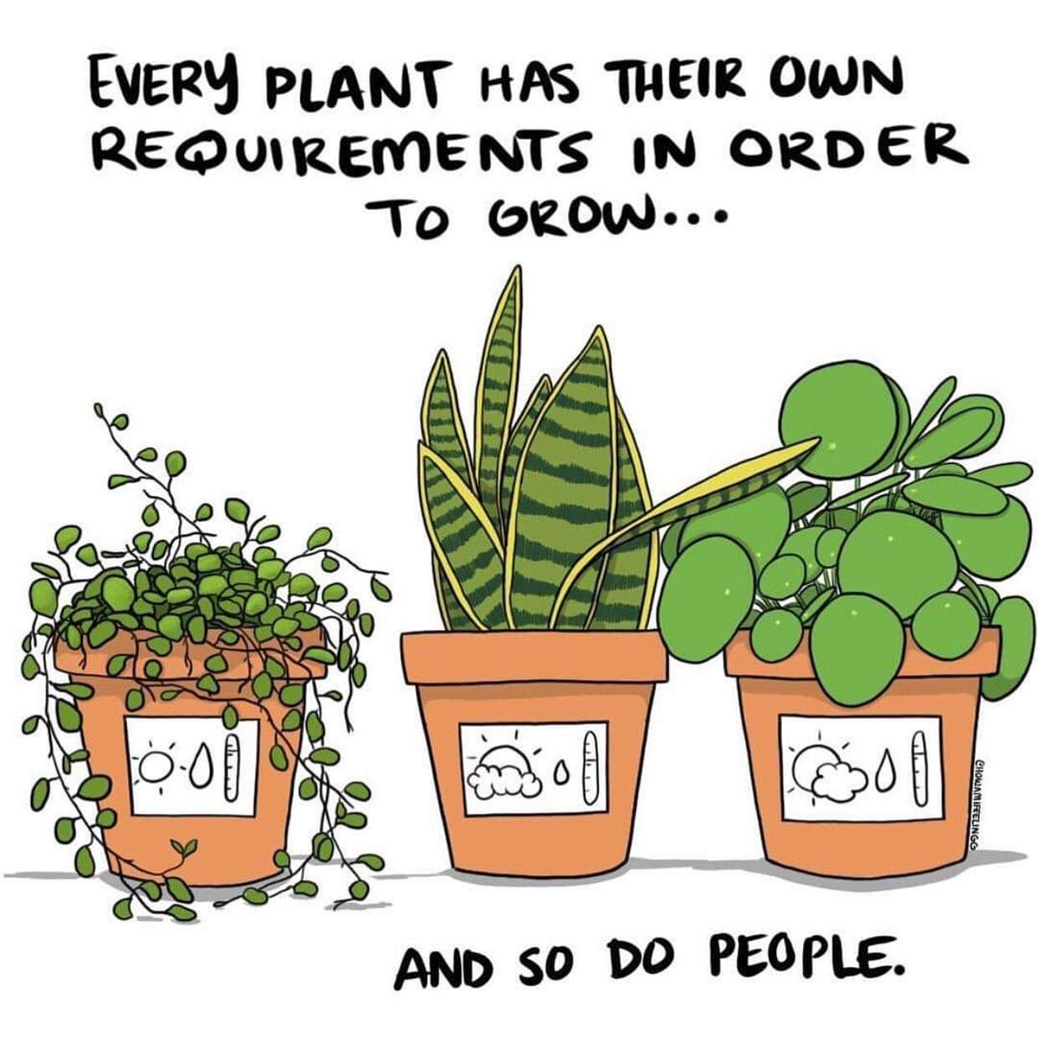
2. Grass is greener (where you water it)
Sometimes incentives (small rewards) a very powerful way to influence behavior.
Pick one observable behaviour at a time. Check consistently.
Use exciting but doable rewards.
Stop the rewards slowly.
This technique is simple, but there are several common pitfalls.
If this has gone poorly for you in the past, know there are work-arounds.
Notes:
Image credit https://share.google/images/AcdmrmN8S2GICLPy9

Slide 24
2. Grass is greener (where you water it)
Time banking (deliberately spending more time with a kid) can also help.
This is because often when a kid is being difficult, we naturally pull away from them.
This can lead them to try more and more extreme behaviors to get your attention.
Spending more (quality) time with them can reverse this cycle.
Notes:
The more difficult the behaviours, the more time this technique takes.

Slide 25
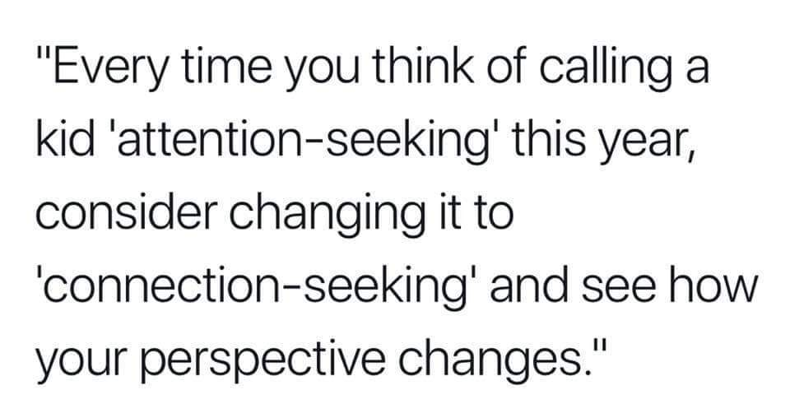
Notes:
Image credit https://share.google/images/DK7GQsf2oZNXdcErV
The more difficult the behaviours, the more time this technique takes.

Slide 26
3. SMART Goals
Sometimes kids with ADHD aren’t following through because the goal is too hard or vague.
Example: “get good grades”
SMART goals are:
Specific
Measurable
Achievable
Relevant
Time based
Example:
For the next two weeks, I’ll empty lunch box before bed
I get a small candy for each one done on time
and if I make it to two weeks only missing once or twice, we take a trip out for ice cream Friday night
Notes:
*** Candy might not be a great reinforcer right after Halloween.
Remember reinforcers can be things like preferred activities, privileges, etc. Sometimes, agreeing to do something silly and a little embarrassing as a parent works wonders! (ex: Only talking in farts for the next ten minutes). They don’t have to cost anything.

Slide 27

Extinction Burst
When you stop rewarding something you used to reward, the first response is sometimes a burst of much worse behavior
Notes:
Image credit: https://idealspine.com/wp-content/uploads/2020/02/Bend-at-the-Knees-and-Dont-Jerk-or-Twist-A-Brief-Guide-to-Proper-Lifting.jpg

Slide 28
Easier said than done

Slide 29
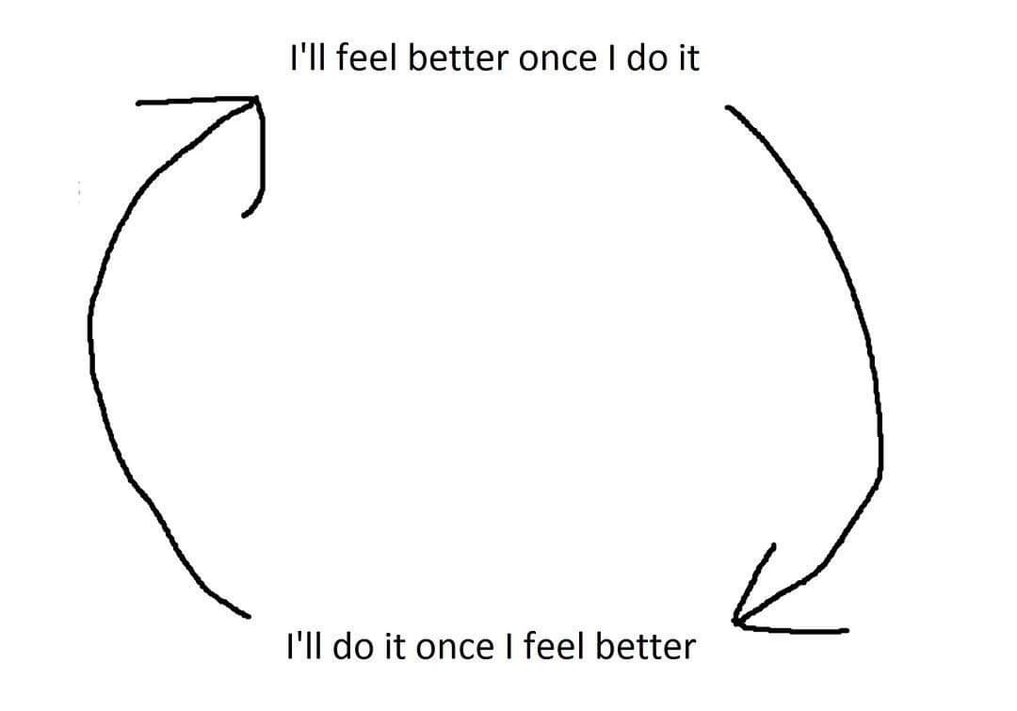
(this is a trap)
Notes:
Image credit https://share.google/images/nl8fd50nemNVGzlDI

Slide 30
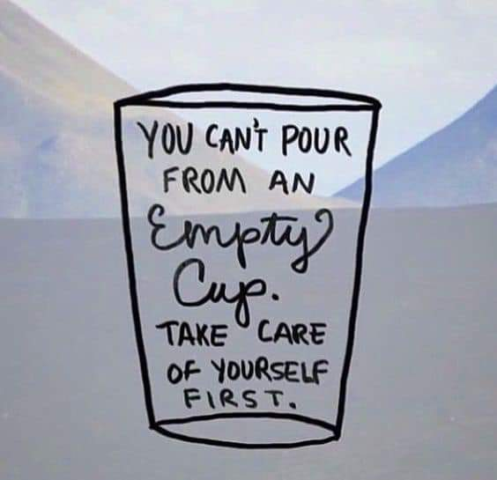
(Easier said than done)
Two main struggle points:
It’s hard to plan when you’re already exhausted
It sometimes gets harder before it gets better
Notes:
Image credit https://share.google/images/lH1p6DrtSHVjpqikm

Slide 31
Already Exhausted?
Some tips to consider:
Set the bar lower
  pick fewer battles
  If juggling: which balls are rubber versus glass?
Do it with more support
  Bullseye metaphor (balanced helping/asking)
Consider putting whole family wellbeing changes first
Notes:
Doing it with more support can be deceptively helpful!
I promise you there are other families in your area who are dealing with many of the same struggles.
It can feel SO GOOD to see it, to connect with others going through it… even if everything stays the same for a while.
Remember there is a give-and-take (they help – you help), but it’s easier than you might think. Many hands make light work.
Families that are struggling can easily slip into isolation.
It takes time to rebuild a social network.
Find somewhere to be a regular, stick with it. Talk to people. Exchange numbers. Schedule a time to have a low-stakes (LOW STAKES) dinner together (ex: meet at the park and order pizza, or take turns hosting at home but no cleaning allowed before they arrive).
Whole Family Wellbeing fist can look like:
Knowing what you need to get back balance, then looking at the parenting work you currently do. Re-assess what is doable.
For example, do you not mind picking up the slack with garbage but can’t stand when they leave things on the floor where you trip? Give the reminders about the garbage a rest, focus on problem solving for a safer floor.
Consider letting the bedtime rule be “in bed by 9” instead of “asleep by 9” if it means they stay in bed and you can rest/prepare for the next day
Not forcing vegetables or sitting still if it means you can start having enjoyable conversations at the dinner table again

Slide 32
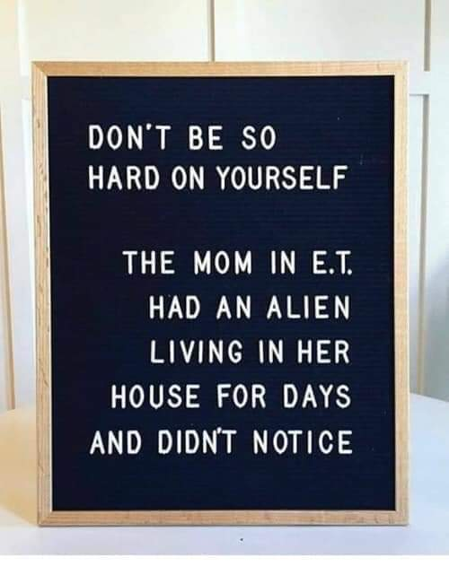
Extinction Burst Tips
Before you make a change, ask yourself what you think might happen
If you think their behavior will be dangerous,
don’t change it yet
Instead:
  Work on other things first OR
  Make the change in a safer environment (safer physical location, more adults to support)
Notes:
Image credit https://share.google/images/cMk0FVMwzbKhlGUaq

Slide 33
Getting More Support
Parent Support Group at the ADHD Clinic
What is near you? What did your family used to do when things were better?
Be a regular. Connections take time, protect that time by scheduling it.
Find parents who are in the same stage, or just a little bit ahead.
Notes:
Image credit https://share.google/images/cMk0FVMwzbKhlGUaq

Slide 34
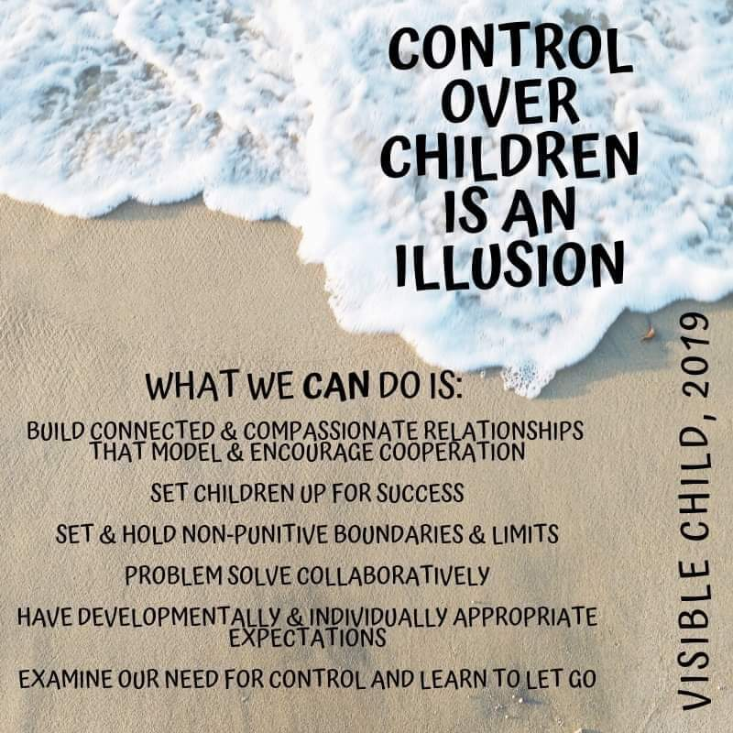
Putting It All Together
Imagine this:
It’s bedtime, the kids are all running around. You notice one kid just got distracted on their way to PJs because they saw a mirror.
You take a deep breath.
Tap them on the shoulder, and say “It’s time for PJs, here’s your PJs.”
They still get distracted on every step, but you’re taking breaks to talk in an evil robot voice together. Tic tacs earned for peeing without making a mess.
Once it’s lights out, they are still wiggly… but in bed with the door closed.
You set an alarm in your phone to leave evening activities earlier for the next two weeks, then re-assess.
Notes:
Image credit https://i.imgur.com/jQtddPC.jpeg

Slide 35
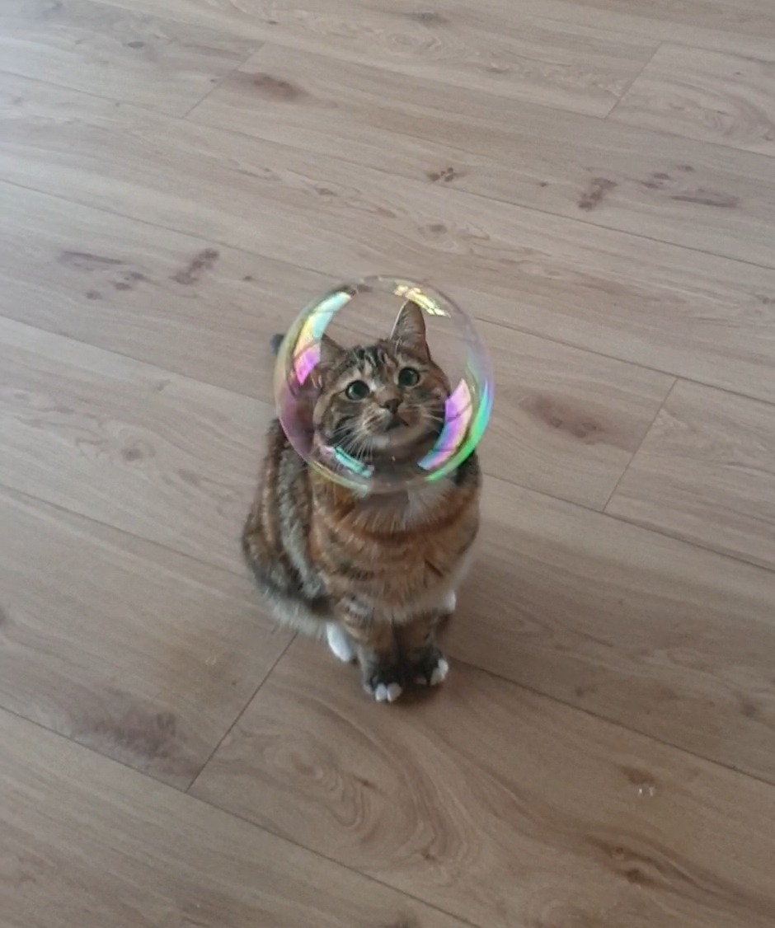
Summary
There is a reason this is hard.
It can get better, with some strategies and patience.
Get out of the pattern;
try something new (you could always try something else later)
You are not alone in this.
(and if you are, get more support before making changes)
Notes:
Image credit https://i.imgur.com/jQtddPC.jpeg

Slide 36
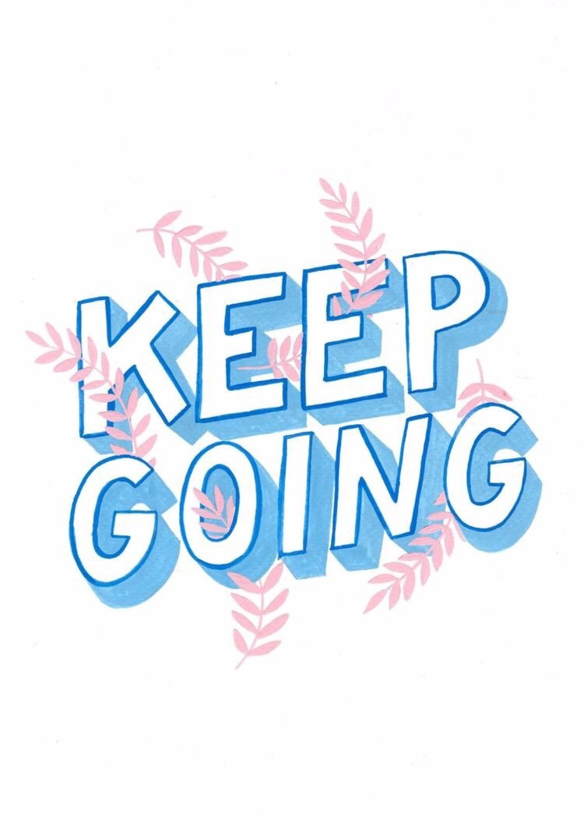
Notes:
Image credit https://share.google/images/hZNeSNczmrquyoQf6

Slide 37
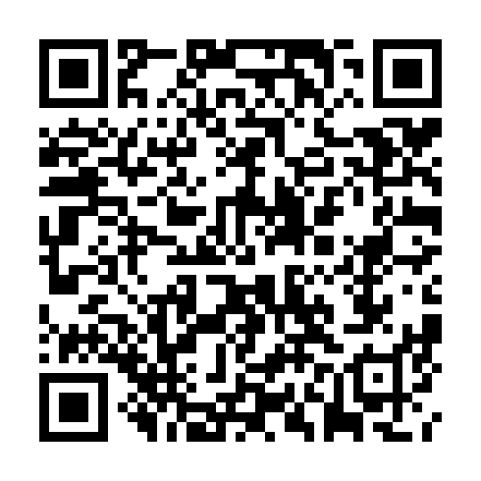
Resources
Rolling With ADHD
5 min Special Playtime

Slide 38
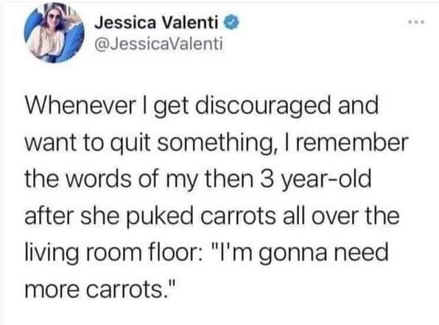
References
Canadian ADHD Resource Alliance (2018) Canadian ADHD Practice Guidelines, Fourth Edition, Toronto ON.
Edwards, G. S., Zlomke, K. R., & Greathouse, A. D. (2019). RUBI parent training as a group intervention for children with autism: A community pilot study. Research in Autism Spectrum Disorders, 66, 101409.
Faber, A., & Mazlish, E. (2012). How to talk so kids will listen & listen so kids will talk. Simon and Schuster.
Gillis, R. (2021) Parenting a Child With ADHD. ADHD Education Day. [Presentation]. BC Provincial ADHD Clinic
Murray, C., Dokis, D., & Gillis, R. (2022) Rolling With ADHD For Families. Retrieved from: https://healthymindslearning.ca/rollingwith-adhd-for-parents/
Laithland, G. (2024) Momma Cusses: A Field Guide to Responsive Parenting & Trying Not to Be the Reason Your Kids Need Therapy. St. Martin’s Essentials, New York, NY
Lavoie, R. (1994) Last Oe Picked.. First One Picked On: Learning Disabilities and Social Skills. [Video]. :Retrieved from: https://youtu.be/TyaHlOYtkI4?si=N9MoaUAVHuQ7ZiZA
Orben, A., & Przybylski, A. K. (2019). The association between adolescent well-being and digital technology use. Nature human behaviour, 3(2), 173-182.

