Slide 1

ADHD Caregiver Journey and Resources
Presented by Joerg Taylor-Philippin, Registered Social Worker
B.C. Provincial ADHD Clinic at B.C. Children’s Hospital
ADHD Parent Education Day – October 26, 2026

Slide 2

Provincial ADHD Clinic at BC Children’s Hospital, Healthy Minds Centre
The B.C. Provincial ADHD Clinic is part of the Outpatient Psychiatry Department at B.C. Children’s Hospital. We are a multidisciplinary clinic, providing assessment and short-term treatment for children with ADHD aged 6-18 years old with complex presentations from across the province. We provide assessment and diagnostic clarification, treatment recommendations, education and support, team-to-team consultation, parent support group, and short-term individual or group intervention as appropriate. The team consists of psychiatry, psychology, social work, occupational therapy, and other allied health professionals. Referrals are made by pediatricians to the Outpatient Psychiatry Department.
Please contact clinic Social Worker Joerg at 604-875-2081 or joerg.taylorphilippi@cw.bc.ca if you have any questions.

Slide 3
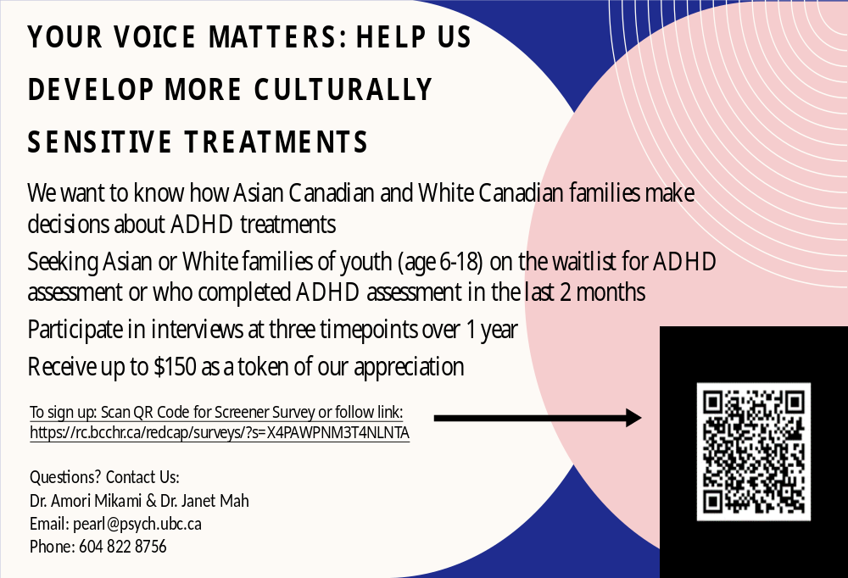

Slide 4




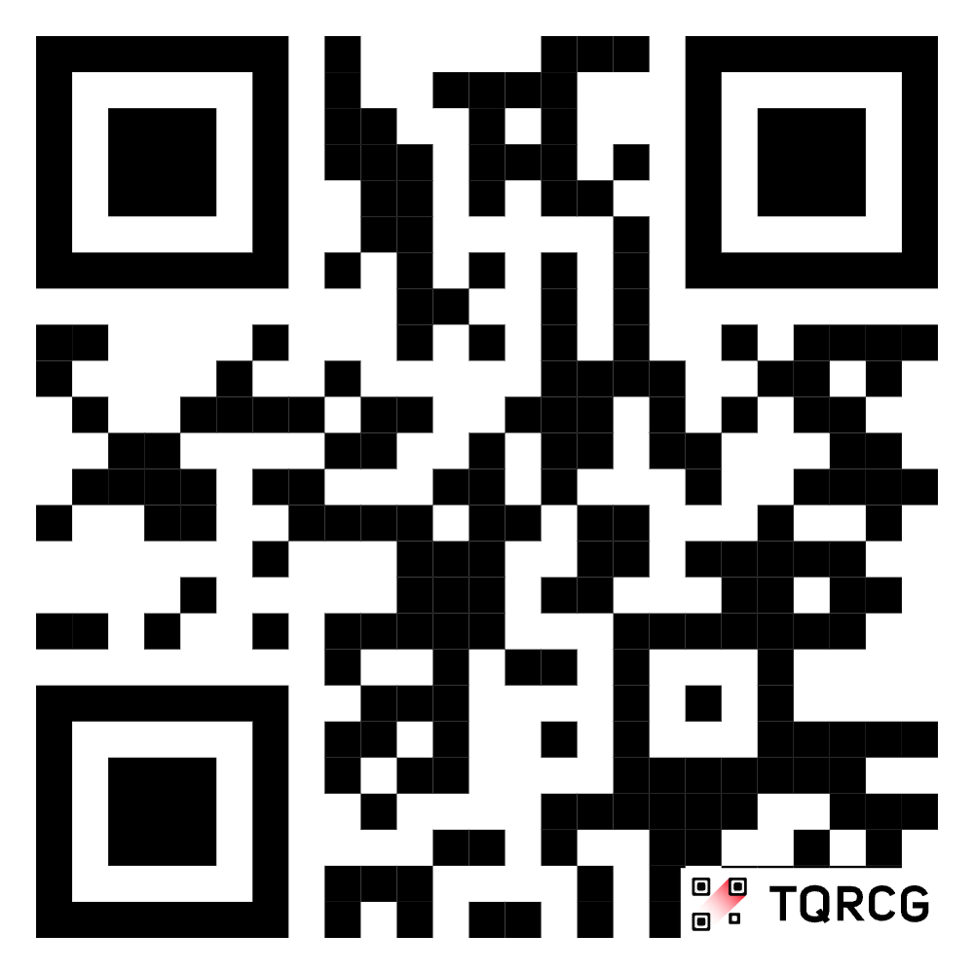
PREFERENCES FOR
PARENTING INTERVENTIONS
RESEARCH STUDY
We want to better understand caregivers’ preferences and needs for parenting programs. Your input will help us improve treatment matching, engagement, and outcomes in the future!
Participate in a one-time online survey (30-60 minutes)
Earn a $25
e-gift card and
receive a personalized
preference profile
Seeking parents of children aged 3 to 8 whose child has received professional mental health care within the past year.
Contact Us:
Email: mah-lab@bcchr.ca
Phone: 604-875-2000 ext. 4726
Study approved by the University of British Columbia / Children’s and Women’s
Health Centre of British Columbia Research Ethics Board (UBC C&W REB)
H25-04116

Slide 5

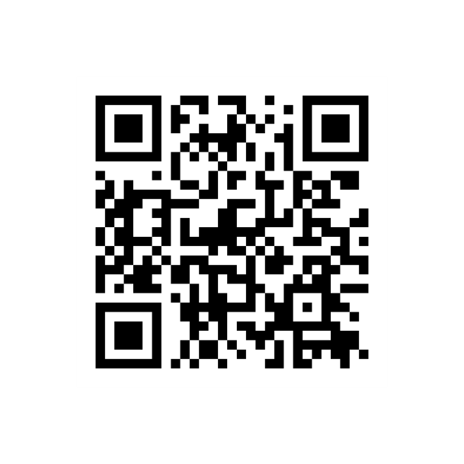



The BC Children’s Kelty Mental Health Resource Centre provides mental health and substance use information, resources, and personalized peer support to parents and caregivers from across B.C.
Connect with us to discover resources, learn about support options, and to find a listening ear. All services are free and no referrals are required.
How to reach us:
TF
1 800 665 1822
W
keltymentalhealth.ca
E
keltycentre@cw.bc.ca

Slide 6

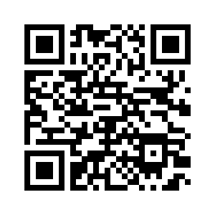
What is ‘Rolling with ADHD’?
Free, online resources to support children and teens with ADHD, and their caregivers and teachers:
ADHD Basics 1 video (20 minutes)
Parent series 8 videos (15 min each)
Teacher series 10 videos (2-7 min each)
Teen resource Workbook
All resources are accessible in one central hub: https://healthymindslearning.ca/
Notes:
The Rolling with ADHD series was born out of a need for more accessible parent training program, specifically for ADHD. It is a free online resource with an ADHD Basics video, a Parent series, Teacher series and Teen Resource.

Slide 7

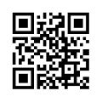

Slide 8
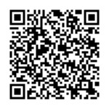

Ministry of Children and Family Development (MCFD)
Child and Youth Mental Health (CYMH) Teams
Community-Based Mental Health Services for Children, Youth and Families
Who We Are
The Ministry of Children and Family Development's Child and Youth Mental Health (CYMH) teams located across B.C. provide a range of mental health assessment and treatment options for children and youth (0-18 years of age) and their families at no cost. Our clinics are staffed by mental health clinicians, psychologists, and psychiatrists.
Updates on CYSN and Autism Funding (New Disability Benefit):

Slide 9

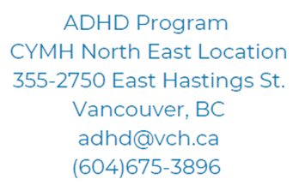
8-Week Parent Psychoeducation Program
A mixture of education, discussion, videos, and practice is presented for 2 hours a week for 8-weeks to parents (virtual).
Making a Referral
Who can refer:
Caregivers, health professionals, school counsellors & social workers.
*Consent is required if making a referral on behalf of a family.*
How to refer?
Email: adhd@vch.ca
Phone: 604-675-3896
Information required:
Child’s first and last name with diagnosis of ADHD
DOB, PHN, or PARIS ID (if available)
Name or caregiver(s) and contact (phone and email address)
ADHD
Child & Youth Mental Health Program
Family-based services for children & youth diagnosed with Attention-Deficit/Hyperactivity Disorder in Vancouver
Community Workshops
ADHD information sessions are held regularly across the city of Vancouver and are open to all community members- including parents, teachers, health providers, and other service professionals.
School-Based Supports
Educational workshops are available to Vancouver school staff upon request.

Slide 10
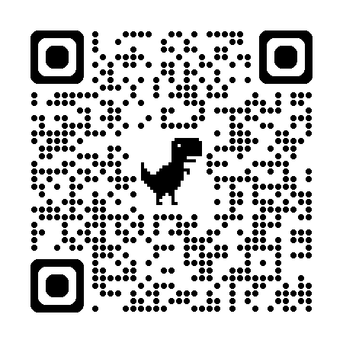
Foundry British Columbia
Foundry provides a range of free and confidential services for youth aged 12-24 and their families in British Columbia, including mental health care,
substance use services, physical and sexual health care, and social services. Services are available in person at local centres or virtually through the Foundry BC app, and include both in-person and virtual support such as counselling, peer support, and workshops.
Key services:
Mental health care: Individualized support for mental health, including counselling.
Substance use services: Support for substance use issues.
Physical and sexual health care: Services like STI testing, birth control, and general medical care through its primary care clinics.
Social services: Assistance with social support needs.
Youth and family peer support: Support from peers who have lived experience.
Employment and education: Programs to help youth with employment and education goals.
Family services: Support for families and caregivers.

Slide 11
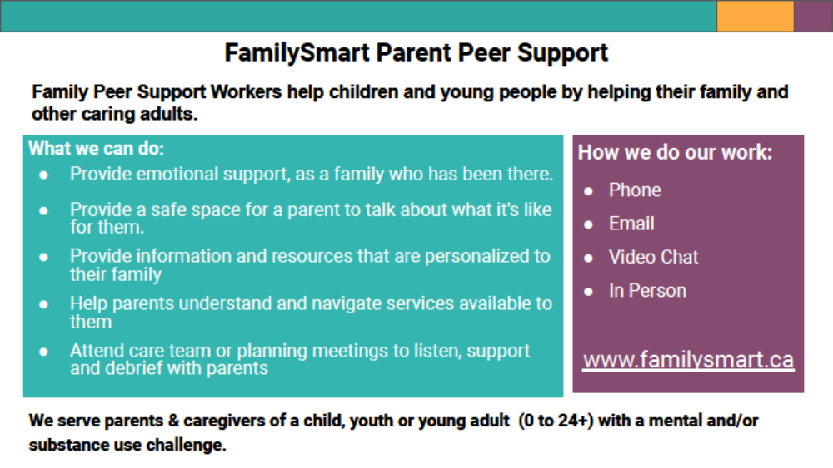
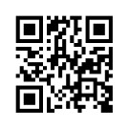

Slide 12
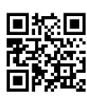
Centre for ADHD Awareness, Canada
CADDAC
CADDAC is a national charity providing leadership in awareness, education, and advocacy for ADHD across Canada. CADDAC is committed to increasing the understanding of ADHD. Through generous donations, CADDAC's programs support parents and individuals affected by ADHD. Key programs and initiatives include CADDAC's Executive Functioning program, group coaching programs, resource navigator program, educational events, awareness initiatives and advocacy initiatives.
https://caddac.ca/

Slide 13

“The Shift”
Provincial ADHD CLINIC at BCCH
Multimodal ADHD Treatment: Medical, environmental, interpersonal – optimizations
Crucial to understand what ADHD really is and what challenges ADHD poses in daily living situations
ADHD parent/teacher/coach education resources ➔ Kelty Mental Health (Rolling with ADHD, etc.)
“The Shift” – adjust parenting/teaching /coaching. Sounds easy but it is not ➔ ADHD coach, BCBA, ADHD Parent/Caregiver Support Group, MARS-PC
It is estimated that those with ADHD receive 20,000 more negative messages by age 10 than those without the condition ➔ Finding opportunities for positive feedback and focusing on the effort, not so much on the outcome

