Slide 1

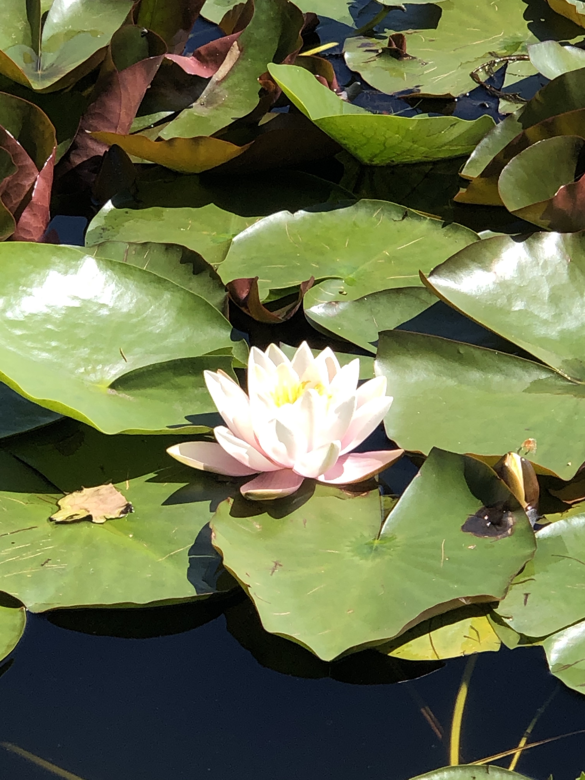


Mindfulness
and ADHD
ADHD Education Day,
BC Children’s Hospital
October 26, 2026
Presenter:
Joanna McDermid MD FRCPC
Notes:
Thank you for the introduction
I’m going to talk about mindfulness and ADHD

Slide 2
OBJECTIVES
  Define what mindfulness is and isn’t
  Consider why mindfulness and compassion can support the ADHD journey
  Explore how to discover more mindful moments in your day
Notes:
These are our objectives
We’ll start by defining what mindfulness is and isn’t.
Next we’ll consider how people become interested in mindfulness and compassion, the evidence behind these practices and how this might become a useful tool for you and your family
We’ll conclude by trying a few practices together and exploring how you might find more moments of mindfulness and compassion in your day

Slide 3

DEFINING MINDFULNESS

Slide 4
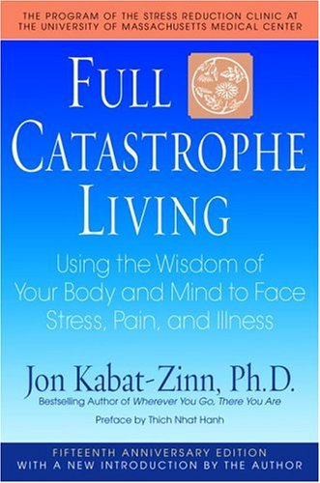
“Paying attention in a particular way:
on purpose,
in the present moment,
without judgement”
-Jon Kabat Zinn
Mindfulness is paying attention here and now,
with kindness and curiosity, and then choosing your behavior
-Sharon Salzburg
Notes:
Lots of definitions of mindfulness, here are 2
On the upper left read aloud
Definition by JKZ, the founder of mindfulness- based stress reduction clinic or MBSR in the late 70’s
On the lower right, read aloud
Definition by Sharon Salzburg, mindfulness and meditation teacher, author and co founder of the insight meditation society Barre MA

Slide 5

Attention
Attitude
Intention
“What you practice grows stronger”
-Shauna Shapiro
Notes:
Shauna Shapiro is a psychologist, author and teacher of mindfulness and compassion, who describes mindfulness in terms of these 3 qualities of mind
Attention is a precious resource and universal human capacity. we can choose where we wish to focus our attention.
Intention which gives us a sense of direction, of motivation, helping us to remain connected to or discover our deepest values.
Attitude: not only important that we pay attention, but how we pay attention: with acceptance, with openness, with curiosity, kindness

Slide 6



Beginner’s mind
Notes:
Here we highlight one the qualities of mindfulness is “beginners mind”
This is as if we are experiencing things for the very first time.
Children inherently demonstrate this quality of beginners mind as they do experience their world with wonder. A series of ‘firsts’!
We too can learn to reclaim this capacity, learning from children. We can understand mindfulness as a way of being in the world- staying present, not getting lost in the past or propelled into future worries, but being, here and now, with heart and mind as open as they can be.
Concept of “moments of natural mindfulness”/ it’s already something we do
“Everyone can be mindful. You have probably already experienced moments of natural mindfulness. Perhaps you’ve had times, without even trying to, when you were deeply aware of what you were doing; the only thing that mattered was the present moment—the past and the future seemed to disappear—and you were filled with gratitude for being alive.”

Slide 7
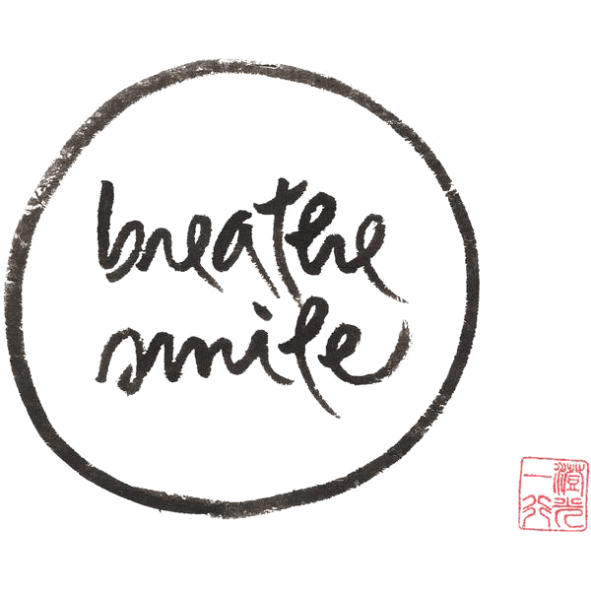

Calligraphy by Thich Nhat Hanh
Notes:
Caligraphy by Buddhist Zen master and peace activist THN
If we had to explaine mindfulness in just 2 words: it would be breathe and smile

Slide 8

What mindfulness is NOT
Relaxation or a technique
Therapy or religion
Passive
Time consuming
About teaching your child to meditate
About perfectionism
Unscientific
Notes:
Just like there are various definitions of mindfulness, there are also some myths or misconceptions. Highlighting just a few here:
NOT the same as relaxation and its not a technique for self help technique although when you practice mindfulness you may feel more relaxed as a result and it can be helpful to cope with stress (we’ll learn more about stress and mindfulness later)
NOT therapy or religion. The practice has ancient historical and cultural roots in traditions in Asia such as Buddhism and yoga and is found in wisdom traditions throughout the world, even though it may go by different names. Practicing mindfulness doesn't ask you to believe in anything, or to not believe in anything.
NOT passive or that it only happens on a meditation cushion or yoga mat, or sitting in silence in a room all by yourself. Mindfulness is active, engaged, a personal and collective pursuit
NOT about taking time out of your busy schedule to rest/relax, another thing to add to your to-do list

Slide 9
  WHY MINDFULNESS?
Notes:
Now exploring some of the reasons people may have a mindfulness practice or pursue mindfulness training
Mindfulness practice serves as the field guide to the heart and mind

Slide 10
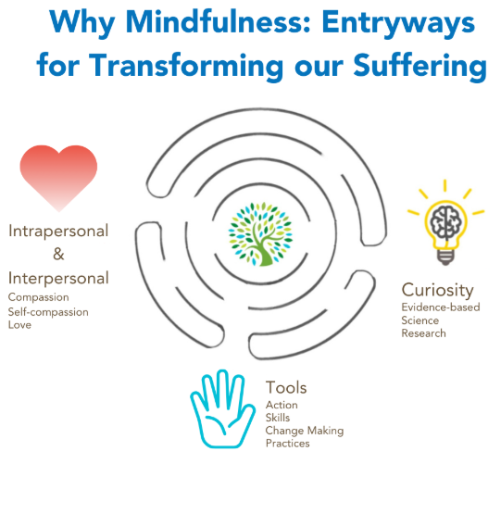
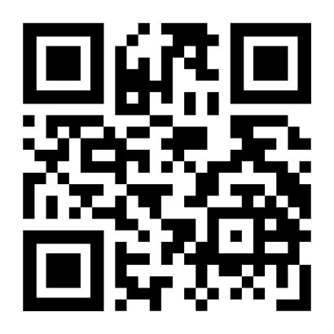
“Heart”
“Head”
“Hands”
“Mindfulness at its best, at its most healing and most powerful, is a way of life, a way of being in the world, with more presence and compassion”
Blogpost from September 2024 authored by Dzung Vo, Charlene Black, Joanna McDermid
Notes:
This is from a blog post you that you find on our BC Children’s Hospital Centre for mindfulness webpage. In our hospital community, we have observed three common entryways into mindfulness or motivations that might draw people into the practice (we call these heart-hands-head)
Each entryway is may appeal to different people and each path is valuable
The entryway of the heart speaks to people who are strongly motivated by values such as love and compassion and caring
The entryway of the hands speaks to a very practical motivation to find tools to address a challenge or difficulty we may be facing in our lives- often this is a very specific difficult situation in life, such as needing to find a way to cope with stress, depression, anxiety or trauma, or survive a very serious health condition, or handle chronic physical or emotional pain
The entryway of the head speaks to an intellectual and scientific curiosity in the emerging field of mindfulness. This is where neuroscientists are documenting how mindfulness can change the way brain functions in response to pain and distress
Here we are representing this mindful path with the ancient image of labyrinth, which represents mindfulness as an infinite journey

Slide 11

Mindfulness based interventions can have positive effects on core ADHD symptoms
* Mindfulness may help lessen (over)reactivity
* Mindfulness may support self regulation
1. Mindfulness and Behavior Change. Schuman-Olivier Z et al. Harvard Review of Psychiatry, vol 28, number 6, November/December 2020.
2. Mindfulness-Enhanced Behavioral Parent Training of Children with ADHD: A randomized Controlled Trial. Mah J et al. Journal of Attention Disorders 2021, Vol.25(12) 1765-1777
3. The effectiveness of Mindfulness Training for Children with ADHD and Mindful Parenting for their Parents. van der Oord S, Bögels SM, Peijnenburg D; J Child Fam Stud. 2012;21(1):139
4. Mindfulness-based psychoeducation for parents of children with attention-deficit/hyperactivity disorder: an applied clinical project. Anderson SB, Guthery AM; J Child Adolesc Psychiatr Nurs.
2015;28(1):43.
5. The Effectiveness of Mindfulness Training on Behavioral Problems and Attentional Functioning in Adolescents with ADHD. van de Weijer-Bergsma E, Formsma AR, de Bruin EI, Bögels SM;
J Child Fam Stud. 2012;21(5):775.
Notes:
Highlighting here some of the benefits of mindfulness, specific to ADHD and ADHD and caregiving.
Starting with the first point (Read aloud)
Neuroimaging studies have shown that mindfulness training appears related to structural changes in the amygdala and increased grey matter volume in the hippocampus. It has been found to lessen ADHD symptoms such as hyperactivity/impulsivity and attention problems, emotional dysregulation, while increasing self-directedness and self-regulation. These and other improvements in mood, anxiety, and social behaviour have been reported in children, adolescents and adults with ADHD, with the improvements being maintained over time. Mindfulness may also be a useful tool for parents to improve their interactions with their children with ADHD [400-406].
I placed an Asterix beside the last two points (read aloud) One of the foundations of parenting a child with ADHD is the caregiver self care and self regulation. This self regulation supports co-regulation. In later talks, we’ll hear more about the importance of the positive caregiver child relationship and of supportive and structured environments
In small unblinded pilot studies, 8 to 12 weeks of mindfulness training for сhilԁren with ΑDНD and/or their caregivers was associated with decreased caregiver-rated ΑDНD symptoms and caregiver stress. These observations indicate that mindfulness may be beneficial as an adjunct to a comprehensive ADΗD management program that includes behavioral interventions and pharmacotherapy as indicated. However, larger and more robust clinical studies are needed to determine the optimal patient population and approach.

Slide 12

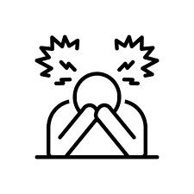
The role of stress
Notes:
Now considering the role of stress and the ADHD caregiver journey
Parental stress can impact children and children’s stress can impact parents
ADHD can make it more challenging to parent so understanding and managing your stress response can help you cope
From the perspective of interpersonal neurobiology (interdisciplinary approach to understanding human development and functioning through the interaction of social and biological realms), the internal state of the parent/caregiver plays an underlying role in creating the culture, emotional environment and learning experience of the child
The presence of healthy well-regulated adults is important for the development of skills of self regulation, self-soothing, impulse control, and maturity of neurological structures and functions that support these skills

Slide 13

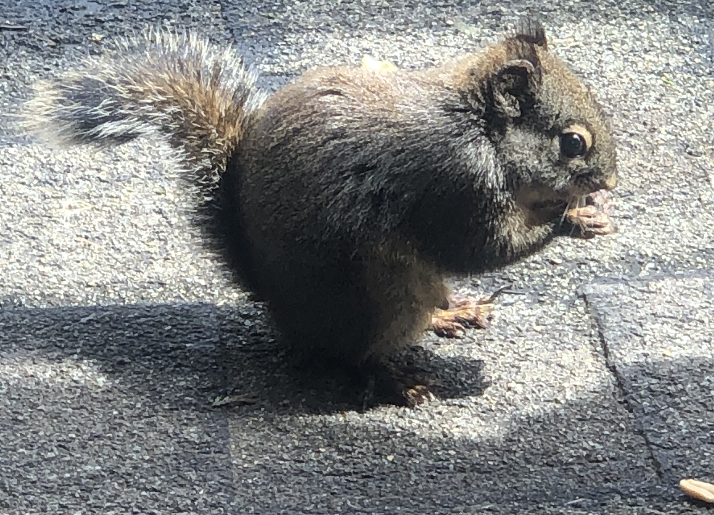
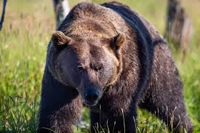
(Fight, flight, freeze)
Notes:
Briefly reviewing the stress response and why our biology is relevant here. We can see here the squirrel and the momma bear. When we’re stressed the body and mind react. In the extreme it’s a survival reaction-fight-flight-freeze- which is protective and helps us survive danger. It happens automatically and quickly, but it can also make us reactive in our relationships. Our stress reaction can have a negative impact on caregiving- we can be more impulsive, angry, impatient, less skillful. When we’re stressed we may also be more likely to make negative assumptions about behaviors: so and so is trying to ruin my day, He’s doing this on purpose, She is trying to get back at me. When stressed, we may have more negative thoughts like “I can’t handle this…not again. This is too much.” We might have an urge to yell or to retaliate or to walk away. There can be tension in the body. We could feel scared, overwhelmed, frustrated.
If we can start to notice the early warning signs of stress in our body (increased heartrate, tense shoulders, clenched jaw, queasy in the stomache, butterflies), we can become less reactive and this can have a positive effect on parenting, relationships, capacity for empathy
Mindfulness can help us recognize our bodies signals of stress, and slow down our automatic reactions
So instead of reacting automatically, we can be more intentional we can choose our response
Perhaps consider what you are more likely to notice first in yourself when you’re stressed? And how you can settle or ground yourself?

Slide 14
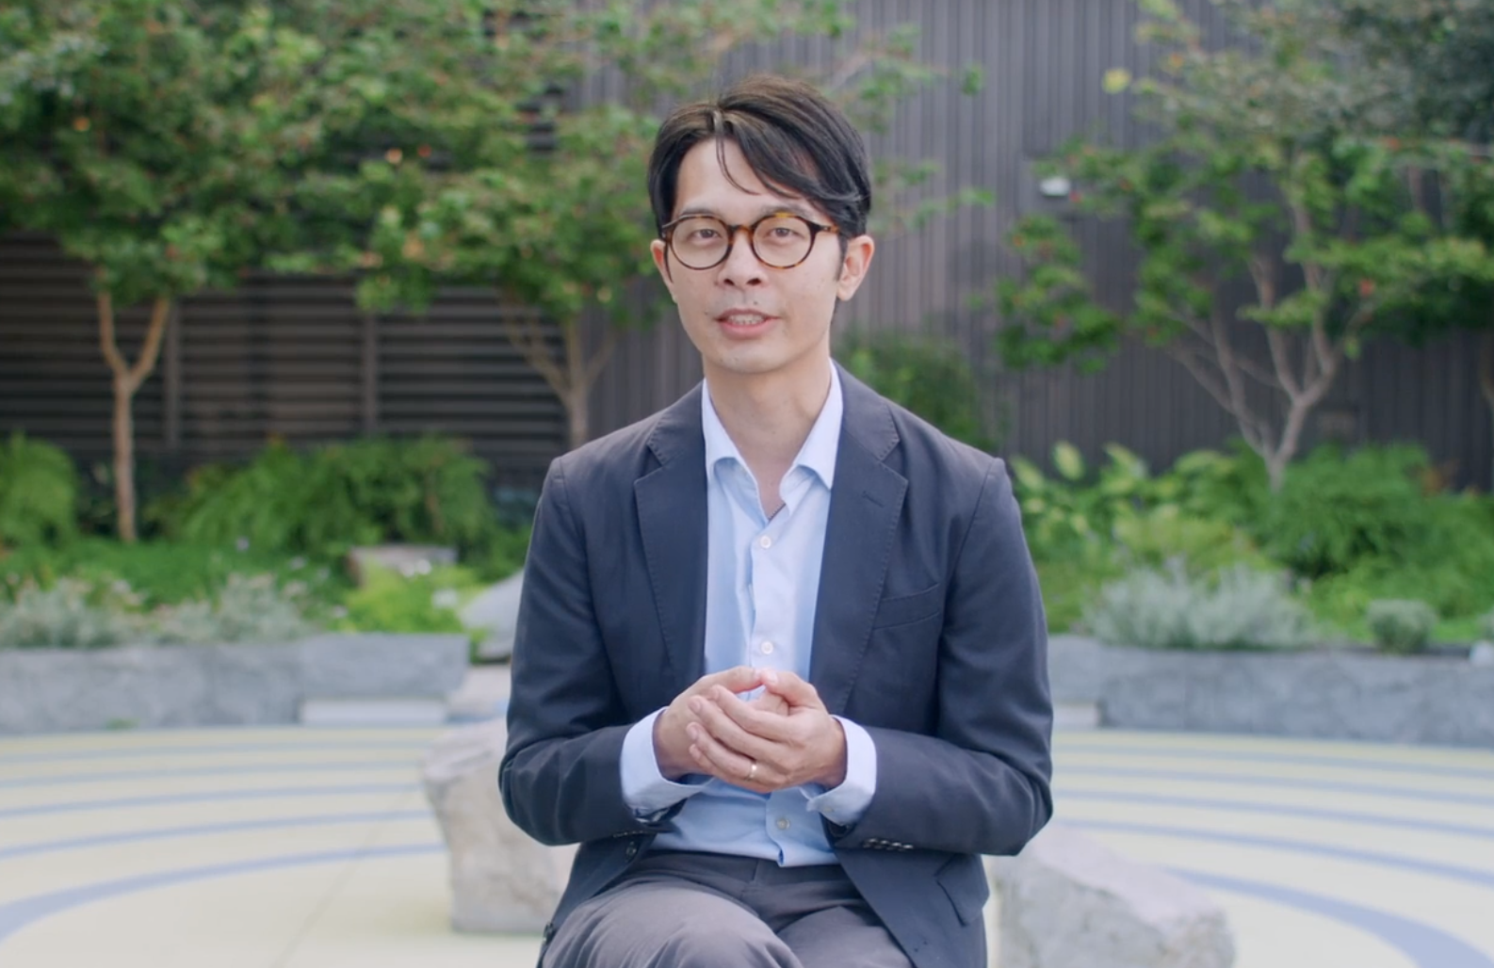
February 14, 2023
Cover Option 1
Uiam nim comnitassum et hario ipidellupta illiquiatur
Short clip:
Hand model of the brain
(Dan Siegel)
https://www.youtube.com/watch?v=gm9CIJ74Oxw
Notes:
Now we’ll share a short clip on the hand model of the brain
https://www.youtube.com/watch?v=gm9CIJ74Oxw

Slide 15

Mindfulness can help us with the stress response…
Reaction
(habit/automatic)
Response
(intentional)
…And to be more present
Automatic pilot
Mindful awareness
Notes:
Mindfulness can help us to cope when we are stressed.
Moving from reaction to response, so parenting with intention
Theres also the busy pace of life and the endless to do list. We can do routine activities automatically, we can be fast and efficient, as if we are on automatic pilot- we don’t need to pay too much attention to the task we are doing. In this mode of being we might get a lot accomplished but we might also not be as attentive, present or engaged as we wish to be
Mindfulness can help us to be more present, to move from automatic pilot to more attunement/awareness

Slide 16
“The pause” between experiencing stress and reacting is a crucial skill that mindfulness training can develop
You can follow three breaths mindfully whenever you notice signs of stress
Pause….breathe…begin
Notes:
So with the stress that comes with parenting and ADHD, the pause can be helpful for both you and your child
Read aloud
When reactivity slows down, we can bring more mindful presence to difficult moments in caregiving
We are more able to (use fingers)
1. Recognize when we are caught up, or activated by strong negative emotions
2. Choose our response which is in line with our values
3. Practice kindness and compassion, especially when we miss the mark

Slide 17
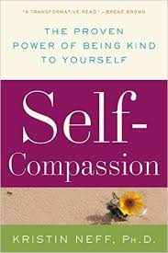
Self-Compassion
“When we suffer, caring for ourselves as we would care for someone we truly love.”
- Kristin Neff
Notes:
So pausing long enough to recognize you are included in your circle of love and care.
Pausing long enough to recognize compassion for others starts with compassion for ourselves and that we can train ourselves in self-compassion. This can help you to stay grounded, focused, comfortable with yourself, no matter how you do
Kristen Neff is a leader in research and interventions to promote self-compassion
(Read quote)

Slide 18

Taking care of ourselves
“It is possible to be at peace with yourself: what was, what is, and what will be. To me, this is the ultimate power: to be comfortable with ourselves and to be our own soulmates.
Soulmate means one who remembers, who knows, and who can master themselves by taking care of their own feelings, thoughts and body.
I always focus on the basics, such as coming back to my breath to come back to myself. Mindful breathing is my soulmate.”
- Sister Dang Ngiem
Notes:
A quote by sister Dang Ngiem physician and then nun

Slide 19
  EXPERIENCING MORE MINDFUL MOMENTS
Notes:
If you’re considering creating your own practice, you can also think of mindfulness as cognitive fitness training- just like you exercise to keep your body in shape, so can mindfulness support a general state of mental well being through ongoing effort.
And recognizing that being mindful in the moment is difficult (interactions are rarely emotionally neutral; when we are emotionally triggered it is more difficult to be mindful in spite of good intentions) so rehearsal or practice is important

Slide 20
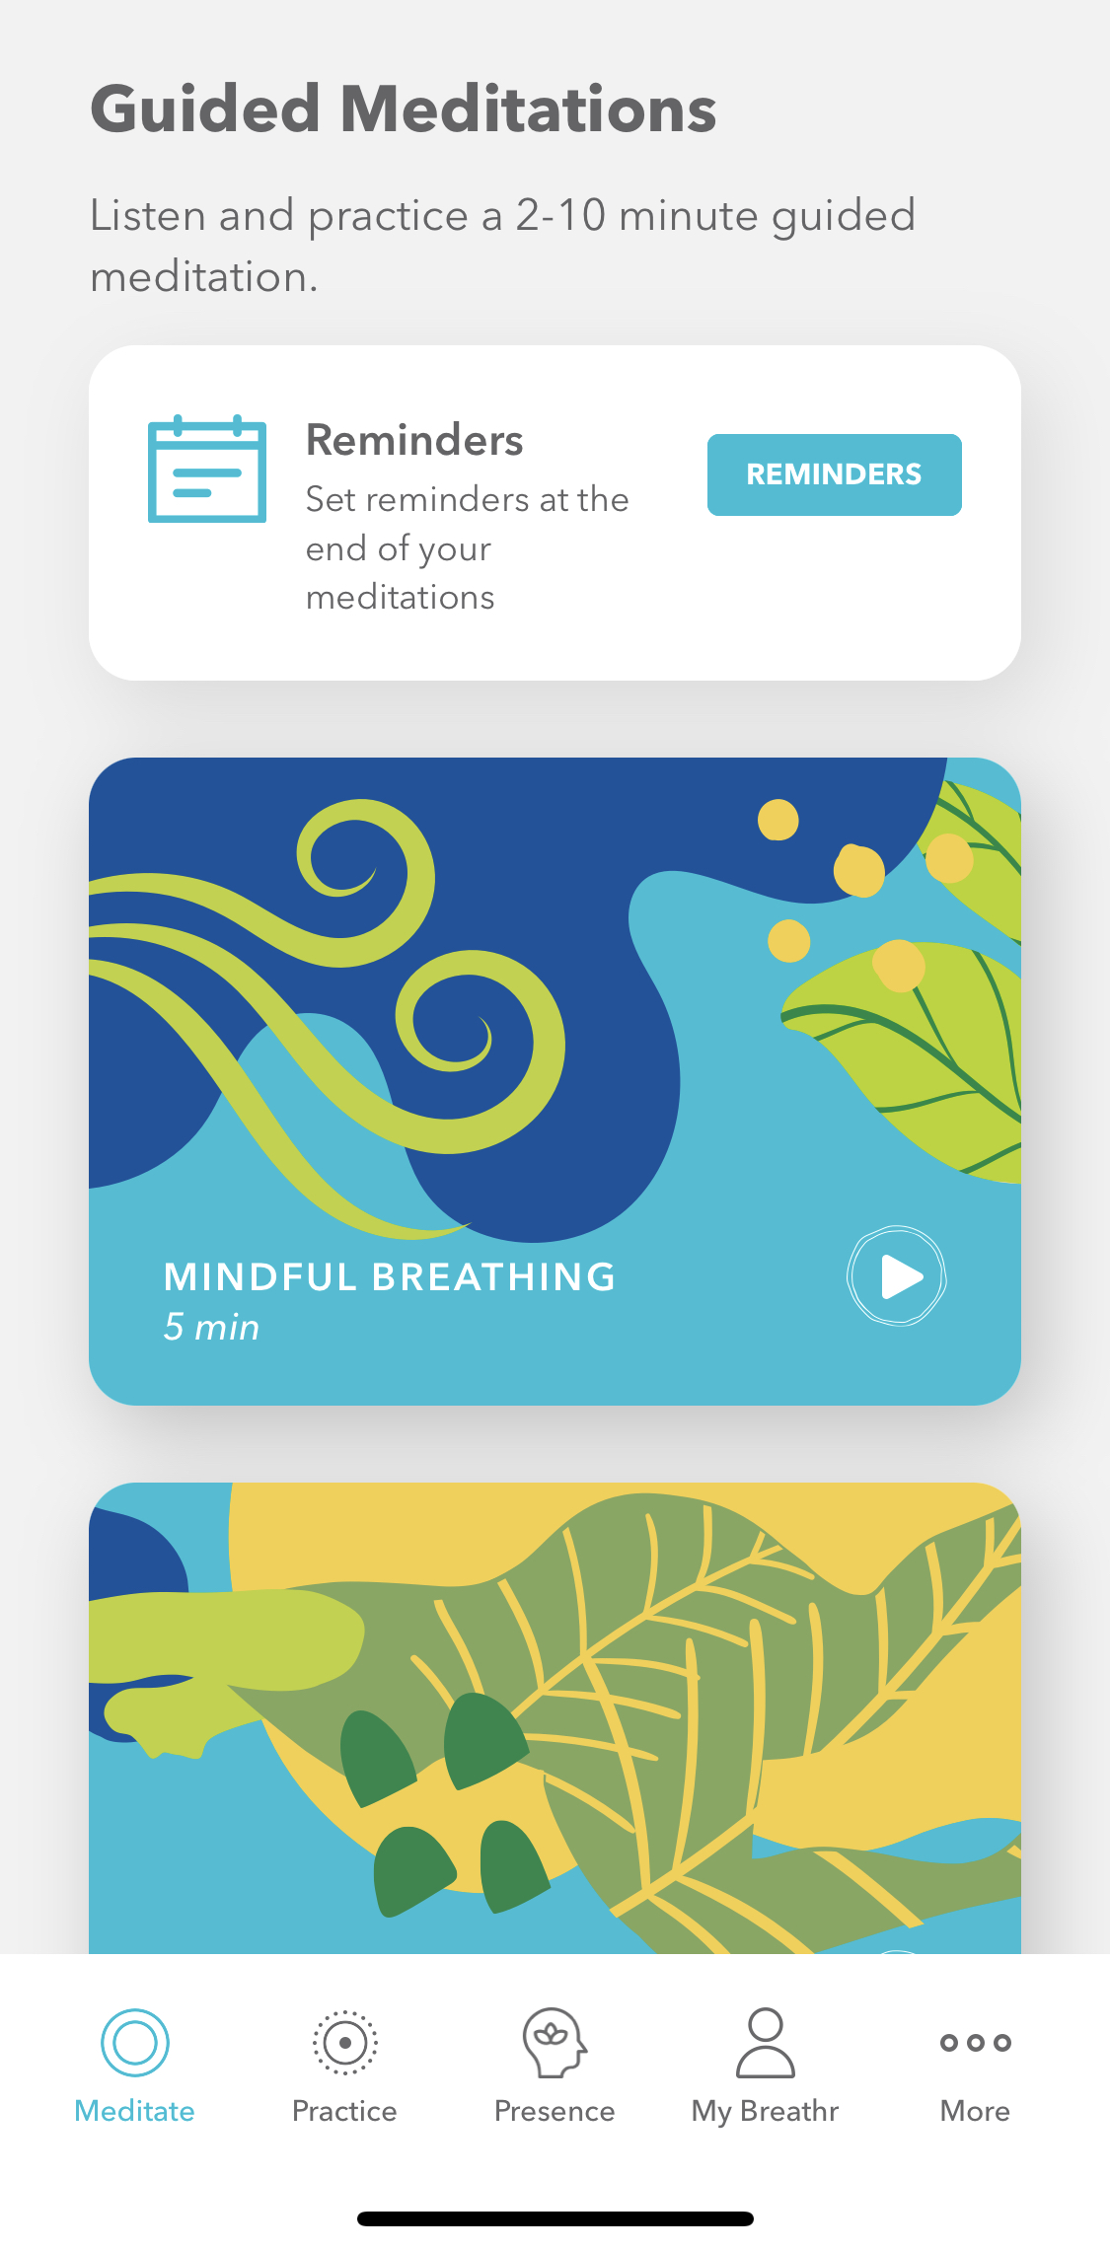
Building the muscle of mindfulness!
Dedicated (‘formal’) and spontaneous (‘informal’) practices
Repetition is intentional
Check out guided practices on Breathr
Notes:
We create our own mindfulness routine through dedicated practice (setting aside some time specifically to be mindful) and spontaneous practice (choosing a routine activity and be mindful with it: washing the dishes, folding the laundry (chores), bathing your child, going to sleep, giving your children medicine or care
shorter & more frequent as opposed to longer & infrequent
There are numerous physical and psychological benefits to practicing mindfulness, including improving emotion regulation and focus-2 key parts for children and parents dealing with ADHD- as well as immune function and chronic pain, anxiety and depression
Read aloud

Slide 21
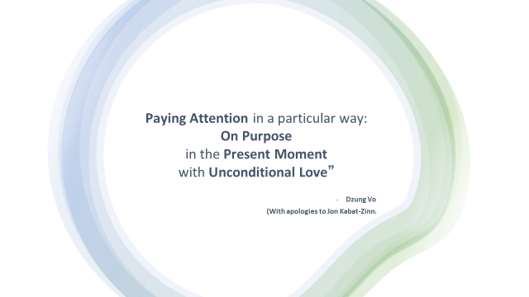

moment by moment
step by step
breath by breath
*noticing positive events
*noting personal strengths
Notes:
The muscle of mindfulness is built moment by moment…
Mindfulness is also about strengths. Recognizing our tendency or negativity bias:
We can notice positive events by being aware of the good things in your life, this can be an antidote to narrowly focusing on the negative
We can capitalizing on positive events by extending and savoring good feelings, telling someone else, writing them down, remembering the events later
We can note personal strengths we can recognize the personal resources and how you enact them in your life, which can be an antidote to feeling helpless

Slide 22

STOP Practice
1. Stop
2. Take 3 mindful breaths
3. Observe
4. Proceed
Notes:
I like the STOP practice that can help to step out of automatic pilot
We can try it now

Slide 23
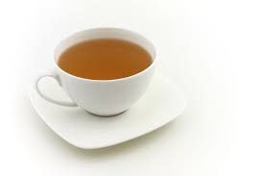
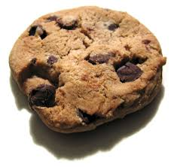
Mindful eating (savoring)
Notes:
Another practice I enjoy is mindful eating
I use the word savor here, because it enriches what’s already good, what we already appreciate. We engage in a pleasant activity and appreciate it while it’s happening
There may be another word that you use that describes the experience of savoring
As per Psychologist Rick Hanson- “have it, enjoy it”. The idea of “positive neuroplasticity”.
We become more grateful through internalizing repeated experiences of gratitude.
Once you’ve got a good experience going, really enjoy it- take 5, 10 or more seconds to protect and stay with it and open to it in your body…
As much as a cup of water fills drop by drop, you’ll be developing resilience
Are there any other activities or moments you might savor?

Slide 24

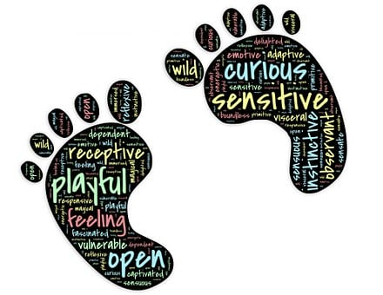
Mindful Walking
Mindful movement
Notes:
One of my favorite ways to be mindful is through movement
This can be especially helpful if there are strong emotions

Slide 25
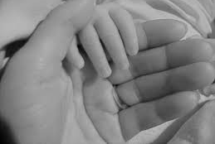
Closing practice
“Love meditation
for your child”
Notes:
We’ll end with some mindful breathing and a listening meditation
In out
Deep slow
Love meditation for my child
May I provide safety and security for you dear one
May I offer warmth and comfort
May I be loving and gentle
May I be patient and wise
May I be consistent in my guidance
May I forgive quickly
May I listen with an open heart
May I speak with kindness
May I be aware of my limitations and have compassion for myself
- Joanna McDermid

Slide 26


PROGRAMS THROUGH BC CHILDREN’S HOSPITAL AND BC CHILDREN’S HOSPITAL CENTRE FOR MINDFULNESS
1. Mindful Awareness and Resilience Skills for Adolescents (MARS-A)
Eight-week mindfulness course for adolescents struggling with psychological distress
-Referral by health care professional
2. Mindful Awareness and Resilience Skills for Parents/Caregivers (MARS-PC)
Six-week mindfulness course * for caregivers whose children are receiving support through BC Children’s Hospital*
-Referral by BC Children’s Hospital MARS-PC Ambassador
Notes:
Programs we offer through the hospital

Slide 27

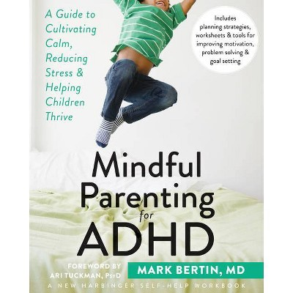
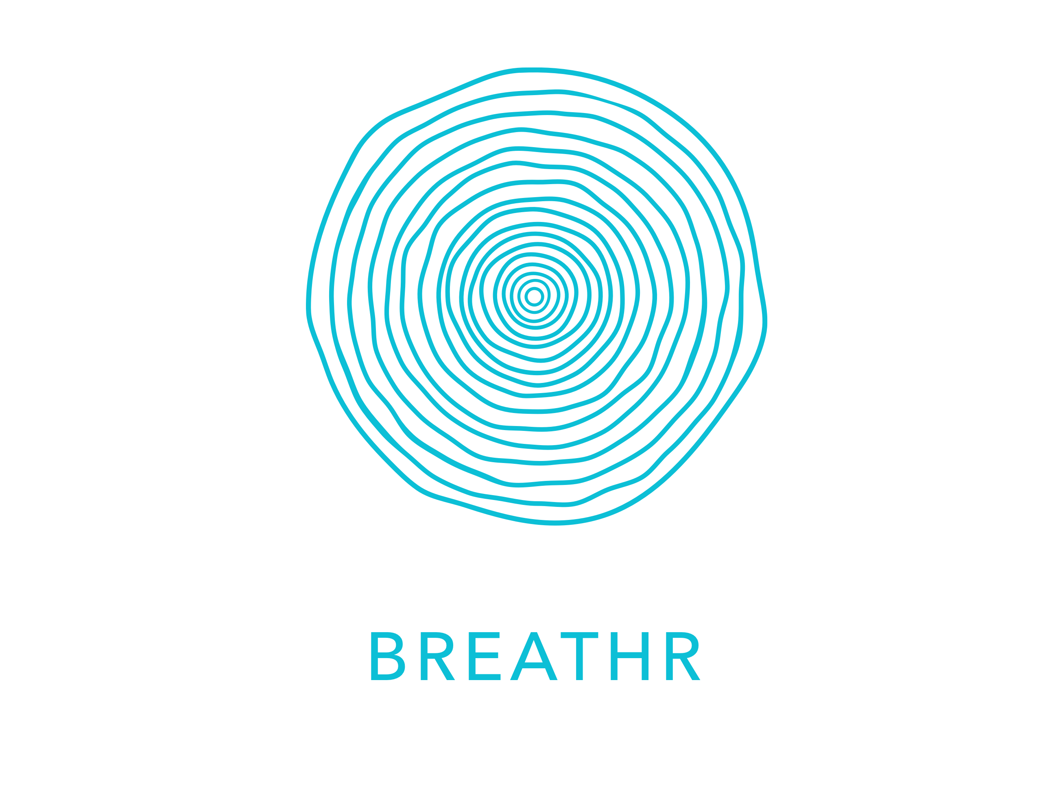
Thank you
Mindful approach to parenting and caregiving:
https://keltymentalhealth.ca/mindful-approach-parenting-caregiving
BC Children’s Hospital Centre for Mindfulness:
https://keltymentalhealth.ca/centre-mindfulness
Notes:
Some additional resources

