Slide 1
MEDICATION TREATMENT FOR ADHD
Susan Baer, MD, PhD; BC Children’s Hospital
Child and Adolescent Psychiatrist
Provincial ADHD Clinic and Compass Program
Clinical Associate Professor Department of Psychiatry, University of British Columbia
Notes:
Intro slide to be up while waiting for presentation to start

Slide 2
LEARNING OBJECTIVES
1. To understand the medication options for ADHD
2. To understand how other conditions can influence ADHD treatment
3. To empower you as parents to be active participants in decision-making around your child’s ADHD treatment

Slide 3
Disclosures
No financial disclosures (no relationships with any pharmaceutical company)
I will be using some brand names for clarity
I will mention one “off-label” medication

Slide 4

Take A Deep Breath…Relax
Find your zone of tranquility… It’s easy to get emotional when it comes to our kids.
ADHD kids are unique despite their symptoms of ADHD. So, it’s no surprise that each parent’s journey of treating their child’s ADHD is unique.
There is no right or wrong decision with regards to treating your child’s ADHD. You know your child best and are a powerful advocate for them.

Slide 5
Multimodal treatment study ADHD--1999
579 kids ADHD
Behavior Tx (B)
Combo (M+B)
Community care
Medication (M)
Kids who got medication had the biggest improvement in ADHD symptoms
Combo group not better than Med group for ADHD symptoms
Combo group had other benefits: oppositional behavior, social skills, and parent-child relationship
Kids in the Combo group needed lower medication doses to get the same benefit!
A 14-Month Randomized Clinical Trial of Treatment Strategies for Attention-Deficit/Hyperactivity Disorder
The MTA Cooperative Group; Arch Gen Psychiatry. 1999;56(12):1073-1086.

Slide 6
MEDICATION TREATMENT

Slide 7
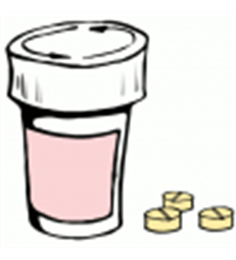
When to try Medication….
ADHD symptoms are interfering with child’s functioning
After evaluation for co-existing conditions
Assessment of cardiac health
Everyone is well educated and prepared for the trial of medication

Slide 8
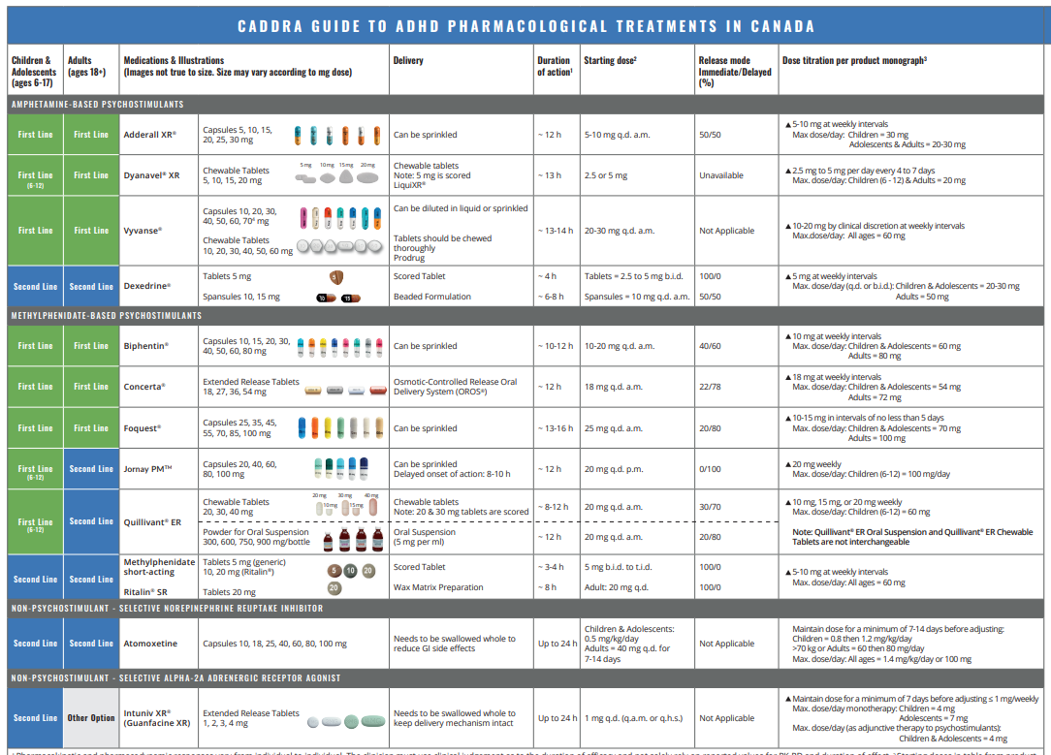
CADDRA TREATMENT GUIDELINES MAY 2026
1ST LINE
  Long-acting stimulants
2ND LINE
  Short and intermediate-acting stimulants
  Atomoxetine = Strattera
  Guanfacine XR = Intuniv
https://www.caddra.ca/wp-content/uploads/CADDRA_ADHD-Medication-Chart_EN_FINAL.pdf

Slide 9
Why are stimulants first line?
Medications are the most effective treatment for core ADHD symptoms.
Stimulants are the most effective medications for ADHD
Over 90% of children will have symptom improvement with stimulant treatment (50% will be in normal range)
Work quickly and can be stopped and started easily

Slide 10

Stimulants: alert and focus your brain
Improve ADHD symptoms:
  Increase concentration & attention
  Decrease impulsivity & hyperactivity/restlessness
Secondary effects:
  Increase work/school productivity and accuracy
  Decrease aggression & defiance (in most children)
  Improve peer acceptance & interactions
  Improve self-esteem
  Improve driving performance

Slide 11
Stimulant medication made simple:
Stimulants
Methylphenidate family
Short-acting: Ritalin
Long-acting: Concerta, Biphentin, Foquest Quillivant, Jornay
Amphetamine family
Short-acting: Dexedrine
Long-acting: Adderall, Vyvanse, Dyanavel

Slide 12
Stimulant family comparison
Methylphenidate family
Amphetamine family
Ritalin, Biphentin, Concerta, Foquest, Quillivant, Jornay
Moderate-strong effect (0.8)
Milder side effects
Often tried first, especially with younger kids
Jornay—option for nighttime administration
Dexedrine, Adderall, Vyvanse, Dyanavel
Strong effect (1.0)
Slightly more side effects
Often tried second especially for younger kids
Vyvanse works well for teens

Slide 13

Stimulants: Side Effects
  Insomnia (50%+)
  Decreased appetite (50%+)
  Irritability, anxiety, flat mood (<25%)
  Stomachaches (<20%)
  Headaches (<15%)
  Worsening of tics
  Growth effects (monitor long term)
  Cardiac effects: increased HR, BP

Slide 14
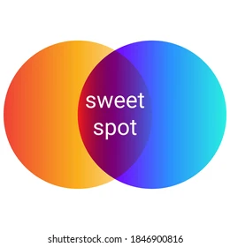
Goal of stimulant treatment is to find the sweet spot…
Enough medication to get the benefits of the stimulants
But not so much that side effects are a problem….

Slide 15
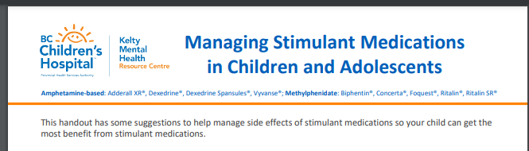
Tips and tricks to manage stimulants
Appetite problems:
  Big breakfast, Boost supp.’s, grazing during the day, evening snack, …..
Sleep problems:
  Give pill early, sleep hygiene, melatonin, switch to shorter-acting med….
Irritability/low mood
  Lower dose, Switch to non-stimulant
Wears off too quickly
  Switch to longer acting form, give pill later, add non-stimulant
Early morning challenges
  Give pill earlier, add low dose short-acting med, try Jornay
https://keltymentalhealth.ca/sites/default/files/resources/ManagingStimulantMedications_2022_0.pdf

Slide 16

When to try a non-stimulant?
Stimulants from both medication families haven’t worked
Stimulants work for ADHD symptoms but cause side effects
Stimulants work but need more full day support
Other factors like sleep and anxiety

Slide 17
Non-Stimulants: 2ND LINE MEDICATIONS
  Guanfacine XR (Intuniv), Clonidine, Atomoxetine (Strattera)
  Must be taken every day
  Dose gradually titrated up when starting and down when stopping
  Takes 4 to 6 weeks patience to see full therapeutic effect
  Less of a “Wow” on core ADHD symptoms, but can be better tolerated and help more with other things
  No abuse potential

Slide 18
Non-stimulant comparison
Atomoxetine
Guanfacine XR (Clonidine)
Noradrenaline reuptake inhibitor
Approved for monotherapy (off-label with stimulants)
Also helps anxiety
Side effects:
  Stomach upset, ↓ appetite
  Headache
  Potential for irritability, energized feelings
  Rare: rash, liver problems
Alpha-2 agonists
Approved for monotherapy and with stimulants
Also helps with sleep, emotional regulation, and tics
Side effects:
    Dizziness
    ↓ Blood pressure
    Sedation
    Dry mouth

Slide 19

“Drug Holidays”
Time off medication: can be weekends, spring break, summer
Easy to do with stimulants
Can allow for catch-up eating and growth
Allows for reassessment of baseline—is medication still needed?
Downsides: impact on child’s functioning at home and extracurricular activities, e.g summer camp.
Harder to do with non-stimulants—but possible to try over summer when there is enough time.

Slide 20
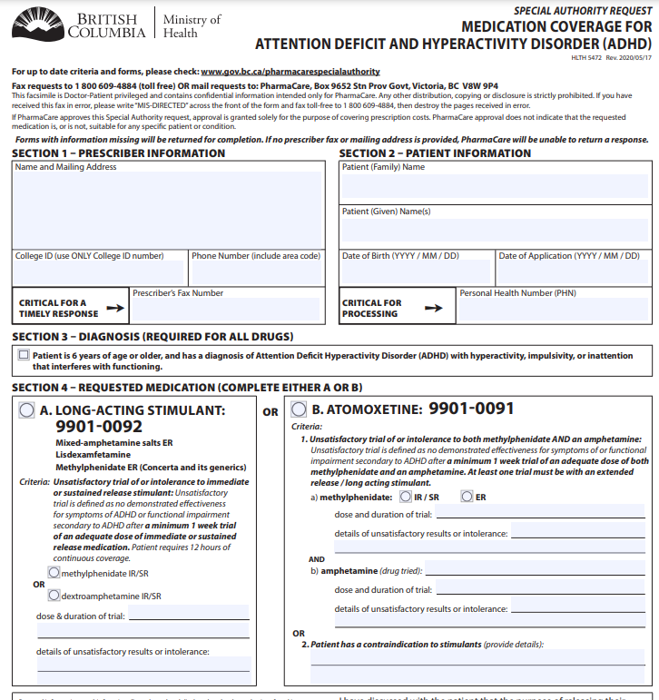
Practicalities: COST
  Pharmacare requires you to first try a short or intermediate-acting stimulant to be able to be eligible for long-acting stimulant
  Pharmacare covers Concerta, Foquest, Adderall, Vyvanse and Atomoxetine
  Other ADHD medications (Biphentin, Quillivant, guanfacine XR) may be covered by extended health plans
  Clonidine is good replacement for guanfacine if not covered
  Go to BC Pharmacare online.

Slide 21
ADHD +: What to do when there’s more than one thing going on?

Slide 22
Comorbidity is common!
ADHD
Anxiety
Depression
Autism
ODD
Learning disorders
DCD
Substance use disorder
Over half of children with ADHD have at least one other condition.
Many children will have two or more other conditions.

Slide 23
How to treat ADHD in children with anxiety?
Counseling
  Cognitive behavioral therapy (CBT) is first line treatment
  Can help with anxiety management and help mitigate impact of ADHD on self-esteem
  Available through CYMH teams, private counselors; visit Kelty for resource lists for anxiety
Mild to moderate anxiety:
  Try treating ADHD first—in many children, improving ADHD symptoms can help decrease anxiety as their lives become less stressful and chaotic
Moderate to severe anxiety:
  Consider starting an SSRI (fluoxetine, sertraline, or escitalopram) first, before starting stimulant medication for ADHD.

Slide 24
How to treat ADHD in Autism
Stimulant medications are still first-line
Watch for activating side effects
Guanfacine XR and Clonidine are good alternatives to stimulants because of their benefit for emotional regulation
Ensure appropriate supports are in place for the child in school and at home
Watch for anxiety—can look different in kids with Autism

Slide 25
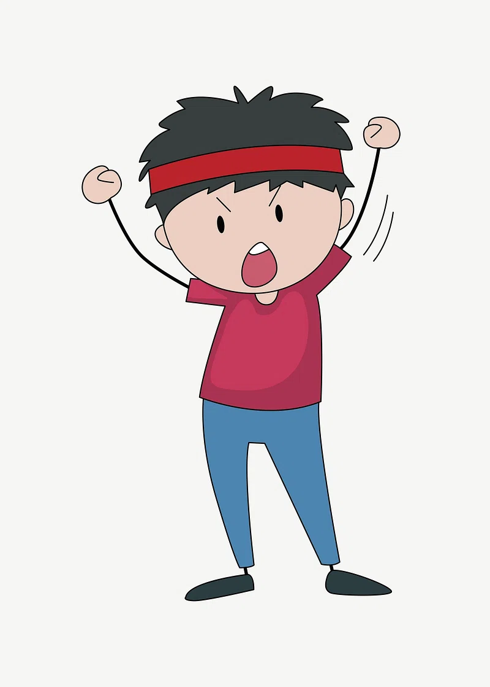
How to treat ADHD in children with ODD?
ODD describes challenging behaviors, but doesn’t say anything about what is contributing to the behavior
Children want to be successful and difficult behaviors are usually the result of poor coping skills which overwhelm the child’s ability to deal with a stressor
Treating ADHD with stimulants generally helps ODD as it allows child to have a bit more of a filter and time to think before they react
Parenting and family interventions are particularly important!

Slide 26

Sleep Problems with ADHD
First line: Behavioral/sleep hygiene approaches
  Better Nights Better Days online resource for sleep in kids with ADHD https://betternightsbetterdays.ca/better-nights-better-days-center
Second line: Melatonin can be helpful in kids with neurodevelopmental disorders
  Shortens sleep onset time by ~ 30 min and increases total sleep time by ~ 30 min
  Give 30-60 min before bedtime,
  Dose ranges poorly defined: Consider up to 3 mg school age kids, up to 5 mg teens
  Adverse effects usually mild but can sometimes cause headache, GI upset, nightmares
  2 yr study of melatonin in kids with ASD showed sustained benefit and no effect on growth or puberty
  BUT—no longer term safety data exists….
References:
Melatonin for insomnia in children, JAMA. 2020 Oct 20;324(15):1559-1560.
European expert guidance on management of sleep onset insomnia and melatonin use, European Journal of Pediatrics. 2024. Bruni O et al.

Slide 27

CONCLUSIONS
For best outcomes, combine medication and non-medication treatment.
Stimulant medications are first-line in almost all cases
The more you and your child become experts in your ADHD, the better able you are to direct and improve treatment outcomes
ADHD medications can protect against negative outcomes of ADHD
Comorbidities are common and can affect choice of treatment

