Slide 1

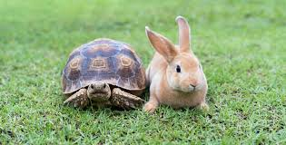
ADHD and
Self-Regulation
Presented by Miranda Doherty, OT
B.C. Provincial ADHD clinic at B.C. Children’s Hospital
ADHD Parent Education Day – october 26, 2026
Notes:
Set up:
Load Mentimeter on Google Chrome: www.mentimeter.com
Remember to sign on to webinar from computer AND phone for BreathR
Good morning everyone. I am Miranda, and I am the occupational therapist and clinic head of the ADHD clinic and I will be speaking about ADHD and Self-regulation.

Slide 2

Learning Objectives
To understand the science behind self regulation and ADHD
To define self-regulation
To learn some sensory and motor self-regulation strategies
Notes:
The learning objectives for this talk include gaining an understanding of the science behind self-regulation and what is unique in the ADHD population, defining self-regulation, and learning some strategies that may be helpful in your own environment and experiences.

Slide 3
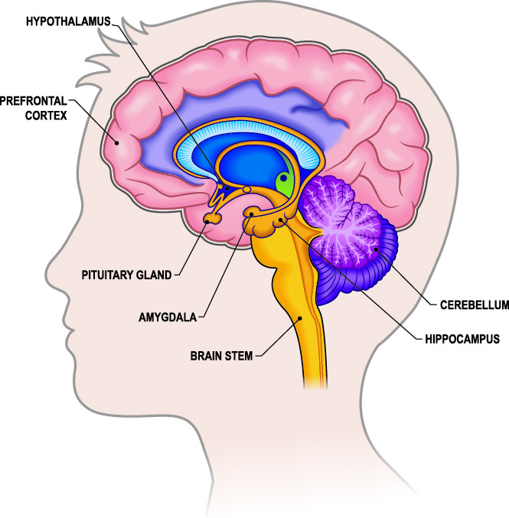
Neuroscience of Self-Regulation
Prefrontal cortex – Executive Functioning
  Dorsolateral PFC working memory, cognitive flexibility, motor planning
  Inferior PFC- inhibitory control, suppress distractions and irrelevant thoughts
Limbic System - Emotions/feelings
  Anterior cingulate recognizes temptation and need for self-control
  Amygdala – processes emotions, fear, anxiety, identifies stressor
Brain Stem - Reptilian brain - for survival
Anterior Cingulate
Kim et al., 2016; Hedgcock et al., 2012. Image from https://qbi.uq.edu.au/brain/brain-anatomy/limbic-system
Notes:
This is a simplified drawing of the brain and some of the main areas that are active in self regulation. The prefrontal cortex is the front part of your brain responsible for many executive functions, including abstract reasoning, working memory, problem solving, decision making, planning, impulse control or inhibition, conscious feelings and emotional regulation. The Limbic system is responsible for processing our emotions and fears, identifying when there is a stressor, recognizing temptations and the need for self-control. When there are big emotions or a stressor is identified, the brain activates a stress response or “fight or flight” signals (sympathetic nervous system). When our emotions take over, the prefrontal cortex shuts off. Dr. McDermid will talk more later about Dr. Dan Seigal’s hand model of the brain, and when a person has flipped their lid. The brain stem and limbic system are working to survive the danger. When the brain recognizes that the danger is over, then the prefrontal cortex turns back on. Self regulation happens when the prefrontal cortex is able to exercise self control over the limbic system. There is a special area called Anterior cingulate that is part of the limbic system, which recognizes a temptation and that self-control is needed. It sends a signal to the prefrontal cortex saying, “Alert, here are your choices with the Halloween candy: eat the candy, don’t eat the candy, eat the candy later.” The dorsolateral prefrontal cortex helps you make the choice, such as eat the candy now. Hedgcock (2013) suggests self-control is a resource that can be depleted when we use up our self control and eventually give in when we are faced with the task repeatedly. We can replenish the self control resource by reducing the temptation and the internal conflict, and by having time away from temptations. So what does this mean for children with ADHD who are trying their best to hold it all together?
_____________________________________________
Five cortical brain structures are highly relevant to motivational states. (Kim et al., 2016)
The prefrontal cortex (PFC) lies behind the forehead and is most notable as the neural home of conscious, deliberate goals as well as of cognitive interpretations and appraisals.
The orbitofrontal cortex (OFC) lies under the PFC and is the brain structure that processes and stores value related information about environmental objects (which can be used to form preferences and to make choices).
The ventromedial prefrontal cortex (vmPFC) processes and stores affect-based information associated with sensory and social stimuli.
The dorsolateral prefrontal cortex (DLPFC) retains goals and involves in cognitive control. Working memory
The anterior cingulate cortex (ACC) monitors conflict in information processing and, when conflicts arise, recruits increased allocation of cognitive resources (e.g., attention, decision-making) from other cortical brain structures to resolve the conflict.
Emotions are physiological, instinctive reactions to specific events, while feelings are the subjective, conscious experience and interpretation of those emotions. Emotions are the body's raw responses, such as a racing heart, while feelings are what we think and perceive them to be, like excitement or anxiety. Feelings are our awareness and labeling of these emotional responses.
Hedgcock, W. M., Vohs, K. D., & Rao, A. R. (2012). Reducing self-control depletion effects through enhanced sensitivity to implementation: Evidence from fMRI and behavioral studies. Journal of Consumer Psychology, 22(4), 486-495. https://doi.org/10.1016/j.jcps.2012.05.008
Kim, Sung-il & Reeve, Johnmarshall & Bong, Mimi. (2016). Introduction to Motivational Neuroscience. 10.1108/S0749-742320160000019022).

Slide 4
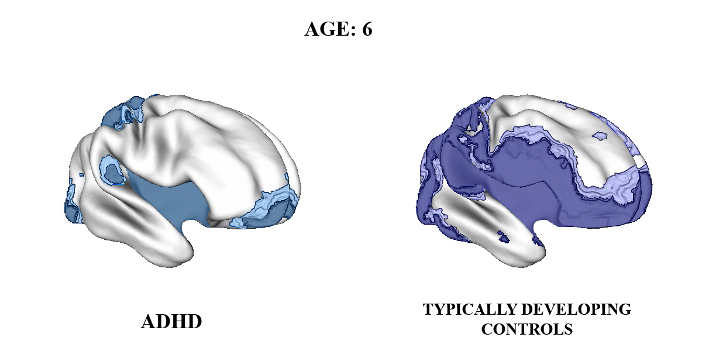
The ADHD Brain
2-5 year delayed cortical maturation
Most prominent delay in lateral prefrontal cortex
Ability to suppress inappropriate responses and thoughts
Executive control of attention
Evaluation of reward contingencies
Working memory
Shaw et al., 2007
Notes:
A study by Shaw et al., (2007) looked at brain development of children with ADHD and without ADHD. They measured brain maturation by the peak thickness of the cortex using MRI brain scans of over 400 children, comparing children ages 5-20 years old. Their study showed there is a delay in cortical maturation of children with ADHD compared with typically developing children, by 2-5 years depending on the area of the brain (with a mean delay of 3 years). The most prominent delay was in the lateral prefrontal cortex, which was approximately 5 years delayed. As mentioned earlier, the prefrontal cortex is important for attention, impulse control, decision making, motor planning, emotional regulation, and working memory. All of this is to illustrate that children with ADHD are developmentally behind, and it is not a matter of needing to try harder, pay attention more, or being more organized, or have more self-control, but it is because their prefrontal cortex is not developed yet and they physically CAN’T.
_________________________________________________________________
Shaw et al. (2007)
estimated peak cortical thickness from the MRI scans of 223 children with ADHD and 223 typically developing children, scanned at 2-4 time points over several years.
The other areas of delay included the superior and medial prefrontal cortex. Posteriorly, the delay in the ADHD group was present in the middle and superior temporal cortex extending to the middle occipital gyri.
Earlier maturation in motor cortex. Higher order motor control = response inhibition (tasks where a motor response has to be inhibited or delayed, such as go-no-go, stop), motor timing (temporal accuracy of movement)
Video images from Shaw, P., Eckstrand, K., Sharp, W., Blumenthal, J., Lerch, J. P., Greenstein, D., Clasen, L., Evans, A., Giedd, J., & Rapoport, J. L. (2007). Attention-deficit/hyperactivity disorder is characterized by a delay in cortical maturation. Proceedings of the National Academy of Sciences of the United States of America, 104(49), 19649–19654. https://doi.org/10.1073/pnas.0707741104

Slide 5
Shaw et al., 2007. https://pmc.ncbi.nlm.nih.gov/articles/PMC2148343/
Notes:
To illustrate, here is a video from the study. The right side of the brain is the frontal lobe and prefrontal cortex. The darker areas are the more developed, more mature areas of the brain. The video shows the change from age 6 – 18 and the difference in cortical maturation between children with ADHD and typically developing controls. From the outset, you can see the difference already at the age of 6. The prefrontal cortex of the typically developing child is already ahead in maturation than the ADHD brain. So, the area of the brain that is needed for children to exert emotional and behavioural self-control, mediate attention, make decisions, and have cognitive flexibility is not starting to develop until age 8-9, compared to children without ADHD. They need to work harder than their peers to meet the expectations for their chronological age for which their brains are not yet developmentally ready. This can lead to further frustration, negative feedback, as well as reduced self-esteem and difficulties with peer relationships.
Maturation of the prefrontal cortex usually happens by the mid-20s on average. For youth with ADHD, the prefrontal cortex may not fully develop until the late 20s or later.
Parts of the PFC and functions:
Dorsolateral prefrontal cortex (dlPFC): Planning, problem-solving and working memory and helping you stay focused by filtering out distractions
Anterior cingulate cortex (ACC): Emotional regulation, making choices and switching between tasks (like changing from washing dishes to drying them) and controlling autonomic functions (like heart rate and blood pressure). The ACC is part of the frontal lob and the limbic system. It is the anterior portion of the cingulate gyrus of the cortex, which encircles the corpus callosum. The ACC serves as a critical connection between the limbic system and the PFC.
Medial prefrontal cortex (mPFC): Adjusting your behavior when rules change (like stopping at a yellow light instead of speeding up)
Ventromedial prefrontal cortex (vmPFC): Judging experiences as good or bad (like feeling happy when you’re with people you trust)
Orbitofrontal cortex (OFC): Making decisions and controlling impulses (like resisting the urge to eat a cookie right before dinner), and helping you judge visual cues by linking them to outcomes or rewards
Video images from Shaw, P., Eckstrand, K., Sharp, W., Blumenthal, J., Lerch, J. P., Greenstein, D., Clasen, L., Evans, A., Giedd, J., & Rapoport, J. L. (2007). Attention-deficit/hyperactivity disorder is characterized by a delay in cortical maturation. Proceedings of the National Academy of Sciences of the United States of America, 104(49), 19649–19654. https://doi.org/10.1073/pnas.0707741104
Tripp, G., & Wickens, J. R. (2009). Neurobiology of ADHD. Neuropharmacology, 57(7-8), 579–589. https://doi.org/10.1016/j.neuropharm.2009.07.026

Slide 6
Important Neurotransmitters in Regulation
Serotonin Well-Being Relaxation Contentment Eating Sleep
Norepinephrine Stress Response “Fight or Flight” Energy Arousal
Dopamine Alertness Reward Pleasure Motivation Drive
ADHD - lower levels of Norepinephrine, Dopamine, and Serotonin
Endurance
Intuition
Appetite
Stable
Mood
Attention
Focus
Guiard et al., 2008; da Silva et al., 2023
Notes:
These three neurotransmitters are highly involved in self-regulation and are interrelated: Norepinephrine, Dopamine, and Serotonin.
Norepinephrine and Dopamine work together for attention and focus. The more pleasure and reward we feel from an activity (e.g. immediate gratification from screentime), the more we can pay attention and can hyperfocus on it. This explains how a child with ADHD can focus really well on things they are interested in, which help them obtain dopamine reward. But they have a very difficult time with activities they find boring because Boring activities do not give us a lot pleasure or dopamine.
Dopamine and serotonin work together like a gas and brake pedal. Dopamine is stimulated from reward-seeking, while serotonin is responsible for feeling happy, relaxed and slowing down. For example, we get pleasure or a reward from eating that leftover Halloween candy and serotonin is released when we are happy, calm and can relax. Serotonin also helps with digestion and to tell us that we are full and to stop eating chocolate. Maybe.
Lastly, Norepinephrine and serotonin work together to help maintain appropriate attention, sleep-wake cycle, awareness of mood and pain perception, and help with social interactions. All three interact and are needed for stabilizing mood and overall regulation.
ANIMATION
As we saw in the last slide, the ADHD brain is known to be neurodevelopmentally delayed in maturation in the areas of executive functioning, impulse control and emotional regulation. And in addition to that, the research tells us that in ADHD, there are lower levels of norepinephrine, dopamine and serotonin, the key neurotransmitters for self-regulation. So, it isn’t surprising to hear that ADHD has also been described as a disorder of executive functioning. Dr. Russell Barkley, who is a well-known respected researcher in ADHD, has suggested that Deficient Emotional Self-Regulation (DESR) be considered a core aspect of ADHD. Children with ADHD are expected to function at the same level of executive functioning and emotional regulation as their same-aged peers, but they are neurobiologically delayed by 2-5 years, and therefore, they need more support, scaffolding and accommodations to be able to participate in their home, school, and community activities.
Guiard, B. P., El Mansari, M., Merali, Z., & Blier, P. (2008). Functional interactions between dopamine, serotonin and norepinephrine neurons: an in-vivo electrophysiological study in rats with monoaminergic lesions. The international journal of neuropsychopharmacology, 11(5), 625–639. https://doi.org/10.1017/S1461145707008383
da Silva, B. S., Grevet, E. H., Silva, L. C. F., Ramos, J. K. N., Rovaris, D. L., & Bau, C. H. D. (2023). An overview on neurobiology and therapeutics of attention-deficit/hyperactivity disorder. Discover mental health, 3(1), 2. https://doi.org/10.1007/s44192-022-00030-1

Slide 7

Self-Regulation Defined
SELF-REGULATION = the ability to attain, maintain, and change arousal appropriately for a task or situation. (Williams & Shellenberger, 1996)
AROUSAL = a state of the nervous system, how alert one feels
How people manage stressors, how much energy we expend and how well we recover (Shanker, 2013)
To be able to understand and respond to others and ourselves
Notes:
What is Self-Regulation? Over the past 10-15 years, the word self-regulation has taken over the ADHD internet. Yet there remains many different definitions of self-regulation. One definition is about the ability to attain, maintain, and change your arousal appropriately for a task or situation. Arousal is the state of the nervous system – or how alert one feels. Another definition by Stuart Shanker, describes self-regulation as how well people manage stressors, how much energy is expended to manage it, and how well we recover afterwards (Shanker, 2013). It includes being able to understand and respond to others and ourselves. He includes the ability to recognize the internal signals of calm and alert, to recognize what is causing you stress, To deal with the stressor, and to recover efficiently and effectively from a stressor.
Self-regulation typically develops around the ages of 8-12 years and for children with ADHD, this can be delayed by 2 years or more.

Slide 8
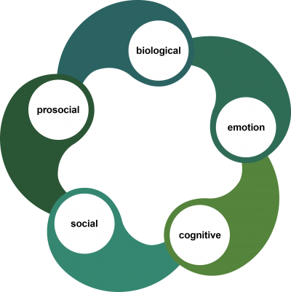
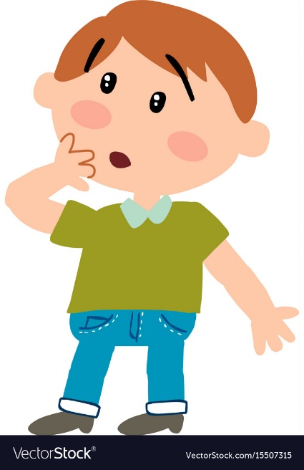
Domains of Self-Regulation
Body, physiological
Empathy, moral behaviour
Emotions, respond to feelings
Appropriate interactions, reading cues
Thinking, processing, attention
Shanker (2013)
Notes:
If we dive further into Self-regulation, Stuart Shanker describes five interrelated domains within a person. They are all connected and influence each other. A person can experience stressors in any of the 5 interrelated domains. The biological domain is related to the physiological self, Emotional is the regulation of emotions and response to feelings, Cognitive includes thinking, processing and attention, Social is our relationships and interactions with others, and Prosocial includes empathy and moral behaviour.

Slide 9
Biological Domain
Physiological regulation
Body systems – motor, sensory, digestive, cardiac, respiratory, etc.
All individuals have sensory and motor preferences
No Right or Wrong
Our preferences influence the strategies we choose to help us regulate our biological domain
Notes:
The biological domain is the most concrete domain for children to regulate because it includes regulating the basic physiological needs, such as physical activity, sensory needs, eating, sleeping, breathing, hydrating, and managing bodily functions. We can think of these functions as all the things we need to do to take care of the body’s internal engine and state. Every individual has sensory and motor needs, and there is no right or wrong with the variations among us. These sensory motor preferences help influence the tools and strategies we choose to help biological self-regulation.

Slide 10
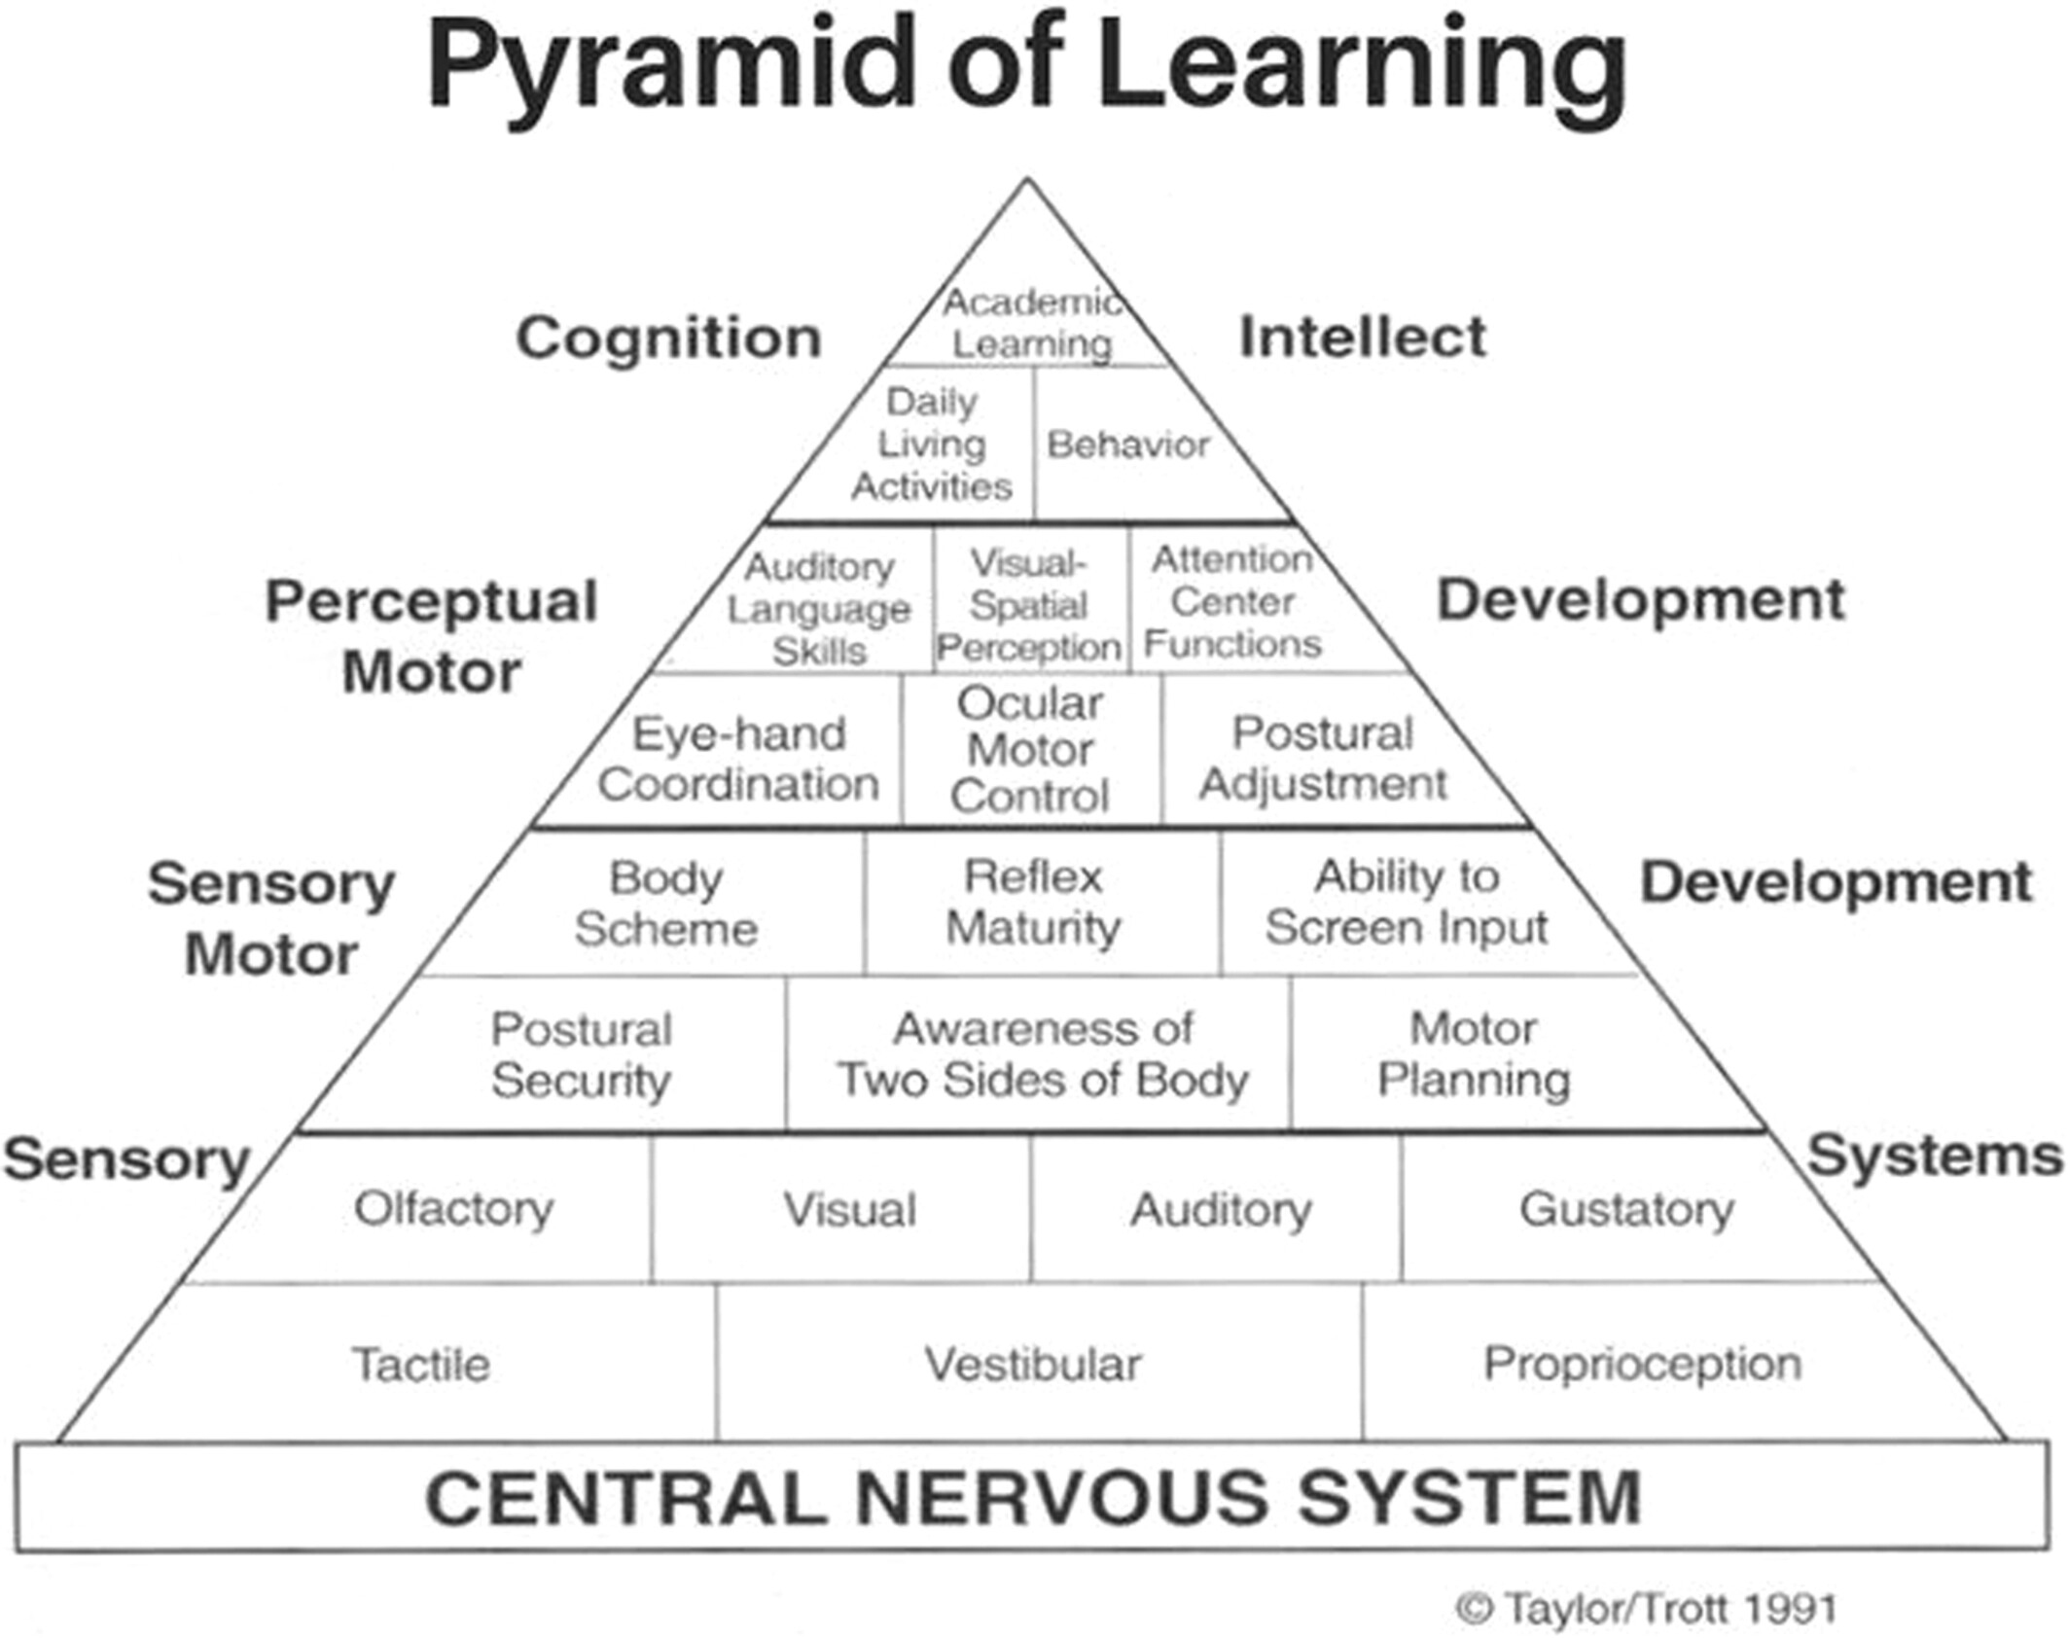
Pyramid of Learning (Taylor/Trott, 1991)
Notes:
Another way to think of the biological domain is that it is at the foundation of the Pyramid of Learning (conceptualized by Taylor and Trott, 1991), where sensory system development is at the foundation. Right above the Sensory Systems is Sensory Motor Development, which is the integration of the sensory system with motor system. The integration of the sensory and motor systems is essential for bein able to move the body around. As you make your way up the pyramid, at the top is cognition and academic learning. If the foundation of the pyramid is not well regulated, then it will be difficult and be unstable for building up to cognition at the top.
__________________________________
Taylor & Trott. (1991). Pyramid of Learning.
Support for Learning, Volume: 38, Issue: 4, Pages: 167-177, First published: 18 September 2023, DOI: (10.1111/1467-9604.12455)

Slide 11
Sensory Motor Self-Regulation
Prosocial = Connect with and care about what others are thinking and feeling, to empathize and act accordingly
Social = Understand both the meaning of a variety of social interactions
Prosocial
Social
Cognitive = Sustain and shift one’s attention and ignore distractions
Cognitive
Emotional
Emotional Monitor, evaluate, and modify one’s emotions
Biological = Attain, maintain, and change one’s level of energy to match the demands of a task or situation
Notes:
In this self-regulation pyramid, highly simplified, the foundation of self-regulation is the regulation of the sensory motor systems. When the basic physiological sensory motor needs are met, the nervous system can be calm and interact with the higher levels of self-regulation. I’ve embedded the five domains of self-regulation from Stuart Shanker on this pyramid.
____________________________________________
Buckley J, Cohen JD, Kramer AF, McAuley E and Mullen SP (2014) Cognitive control in the self-regulation of physical activity and sedentary behavior. Front. Hum. Neurosci. 8:747. doi: 10.3389/fnhum.2014.00747 https://www.frontiersin.org/journals/human-neuroscience/articles/10.3389/fnhum.2014.00747/full
Sensory motor self-regulation occurs at lower levels of the nervous system and supports higher level emotional and social regulation (Williams et al., 2020)
SEL READINESS GAP: Why Emotional Growth Needs a Sensory Foundation - Part 1 - The Alert Program
SEL READINESS GAP: Why Emotional Growth Needs a Sensory Foundation - Part 2 - The Alert Program
Sensory Self-Care for Leaders: Supporting Your Own Engine - The Alert Program
Bottom-Up Strategies for Regulation (from Alert https://alertprogram.com/sensory-self-care-for-leaders-supporting-your-own-engine/)
The Alert Program® emphasizes bottom-up strategies (sensorimotor input that supports the nervous system to achieve and maintain optimal alert levels). These approaches are more effective than relying on top-down reminders to “stay calm” or “pay attention.”
For example, proprioceptive input (often called “heavy work”) such as pushing, pulling, carrying objects, yoga, or stretching can help regulate alert levels. Oral motor input—like chewing crunchy snacks, sipping tea, or using a straw—can be calming, alerting, or even both, depending on the person. Movement strategies, whether walking, gentle rocking, or shifting in a chair, can also help maintain a balanced state. Tactile experiences, such as fidget tools or playing with textures, offer additional ways to self-regulate.
These strategies are highly individualized. What is calming or alerting for one person may not work the same way for someone else. This is why the Alert Program® includes tools like the Sensory-Motor Preference Checklist to help adults identify their own preferences. Effective self-care is not something you do only when you are in crisis. It requires intentionally providing your nervous system with a steady diet of the input it needs throughout the day. That might mean planning movement breaks between sessions or classes, keeping crunchy snacks or water bottles nearby, scheduling time to stretch or walk during transitions, or using fidget tools during meetings.

Slide 12

The Foundation of Self-Regulation
Social Emotional Learning (SEL) is built on the foundation of Biological Self-Regulation (Williams & Shellenberger, 2025)
Many SEL programs assume that a child has already achieved these biological (Sensory Motor) self-regulation skills. (O’Grady, 2024)
Emotional regulation relies on the ability to recognize internal states and adjust. Recognition is impossible if a child cannot reliably interpret the signals within their body. (Ng, 2024)
Notes:
Social emotional learning is built on biological sensory motor self-regulation. A child who is emotionally dysregulated, who doesn’t have the sensory motor tools or know how and when to use them, will struggle with regulating and recovering from an emotional stressor. There is an assumption in many social emotional learning programs that a child has already achieved biological self-regulation skills and are able to absorb new learning.
Ng explains that emotional regulation relies on a person’s ability to recognize the internal state, interpret the signals, and respond to them. However, if a child cannot reliably interpret the internal signals within their body, recognition of the emotional signals is impossible. Dr McDermid will talk later this morning about some tools to help with internal awareness.
_____________________________________
O’Grady, M., et al. (2024). Foundational regulation skills in SEL program implementation. Teaching and Teacher Education, 138, 104420.
Ng, C. (2024). Self-determination theory and emotional regulation development in school settings. [Manuscript].

Slide 13
Eight Senses
Mouth – gustatory (taste) and oral tactile (texture)
Move – proprioception and vestibular
Touch - tactile
Visual - sight
Auditory - hearing
Olfactory - smell
Interoception – internal signals, hunger, thirst, or a racing heart
Notes:
There are actually eight senses (not the five senses we learned in school). Mouth – tastes and textures, Move – Proprioception (sense of muscles and joints), Move – vestibular (sense of balance, inner ear, movement of head), Touch – tactile or the feel of things, Visual, Auditory, Olfactory, and Interoception – internal sensations including hunger, thirst, racing heart.

Slide 14

Sensory Motor Tools
MOUTH
MOVE
TOUCH
LOOK
LISTEN
Interoception
Based on the Alert Program for Self-Regulation. “How Does Your Engine Run?”
Notes:
The sensory motor tools for self-regulation can be thought of as Mouth, Move, Touch, Look, and Listen, based on the Alert Program for Self-Regulation, which is also known as the “How Does your Engine Run?” The sense of interoception is the internal sense that is used to determine which tool or tools are needed.
___________________________________________________
Gustatory and Olfactory - Mouth – this could be biting your nails, biting or touching your lip, drinking coffee or water, crunchy snacks, chewing gum, breathing deeply
Proprioceptive and Vestibular - Move – this includes getting up and stretching, walking, running, stretching, lifting and carrying things, wiggle your foot
Tactile - Touch – this includes using fidget tools, playing with your pen, picking your skin, twirling your hair, stress ball
Visual - Look – sunshine, your smart phone!, video games, low lighting, mood lighting/lamps
Auditory - Listen – music, quiet, white noise, fan
Interoception – internal body feelings – feeling of hunger, thirst, GI system, heart pumping
Other factors to keep in mind which affect your body: the recommended amount of physical activity for children is 60 min./day of moderate to vigorous intensity, remember the impact of sleep, nutrition, emotions and social interactions.

Slide 15
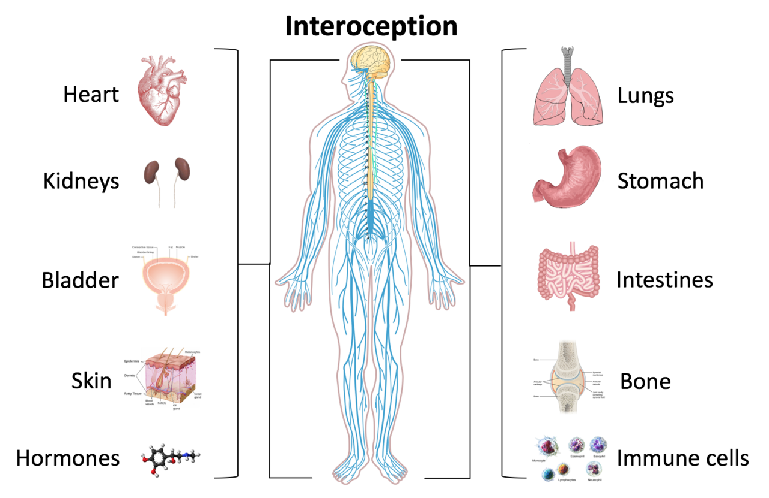
Interoception
= awareness of internal sensations
Three Dimensions of Interoception:
  Interoceptive accuracy - performance
  Interoceptive sensibility - self-report
  Interoceptive awareness - metacognitive
Garfinkel et al., 2015
Notes:
The sensation of Interoception has three dimensions – interoceptive accuracy – how accurately someone can detect an internal bodily sensation. Interoceptive sensibility – self-perception of being able to focus on internal sensations. And Interceptive awareness – metacognitive interoceptive awareness of the accuracy. Do you “know” whether you are accurately or inaccurately assessing your heart beating? The internal sensations are often unrecognized because they cannot be seen. Only the individual who has the upset stomach can feel the upset stomach, or a headache, a full bladder, or if they are hot or cold.
________________________________________________
Interoceptive accuracy (performance on objective behavioural tests of heartbeat detection) - accuracy in detecting internal bodily sensations
Example Can you accurately report when your heart is beating?
Interoceptive sensibility (self-evaluated assessment of subjective interoception) Self-perceived dispositional tendency to be internally self-focused and interoceptively cognizant
Example To what extent do you believe you can focus on and detect internal bodily sensations?
3. Interoceptive awareness (metacognitive awareness of interoceptive accuracy) - Do you “know” whether you are accurately or inaccurately assessing your heart beating?
Garfinkel, S. N., Seth, A. K., Barrett, A. B., Suzuki, K., & Critchley, H. D. (2015). Knowing your own heart: distinguishing interoceptive accuracy from interoceptive awareness. Biological psychology, 104, 65–74. https://doi.org/10.1016/j.biopsycho.2014.11.004 https://www.sciencedirect.com/science/article/pii/S0301051114002294
Image: By Schappelle - Khalsa, S. S., and Lapidus, R. C. (2016). Can interoception improve the pragmatic search for biomarkers in psychiatry? Front. Psychiatry 7:121. doi:10.3389/fpsyt.2016.00121, CC BY-SA 4.0, https://commons.wikimedia.org/w/index.php?curid=61616102

Slide 16
Interoception and ADHD
Interoception is reduced in individuals with ADHD (systematic review, Burton et al, 2025).
Children with ADHD may experience interoception accuracy and awareness difficulties such as:
    Poor accuracy – have trouble recognizing when they are hungry, thirsty, tired, bathroom break, or need a break
    leads to challenges in managing their emotions and bodily needs.
Notes:
Burton et al., 2025 did systematic review and found that there was Diminished Interoceptive Accuracy in ADHD and that Interoception correlated with ADHD symptoms (higher ADHD symptoms = lower interoception accuracy). This suggests that children with ADHD have difficulty detecting the internal signals of being hungry, thirsty, feeling tired, need the bathroom, and if they do detect the signals, they have poor accuracy. An example is the last minute bathroom break or not stopping to eat, which results in a meltdown at the end of the day because a child got hangry.
____________________________________________
They analyzed studies on interoceptive accuracy in individuals with symptoms of ADHD. 12 studies examined the association between interoception and ADHD symptoms (2 child studies, 10 adult studies). All studies were cross-sectional with self-report questionnaires and/or lab tasks. Results: Interoception correlates with ADHD symptoms (higher ADHD symptoms = lower interoception accuracy).

Slide 17
Self-Regulation Programs for Children with ADHD
Evidence of self-regulation programs for ADHD
Best Evidence identified for children with ADHD:
Better home-based outcomes, parent engagement and scaffolding
Alert Program® for Self Regulation
The Incredible Years®
(Prosperi, 2025)
Notes:
A review of the evidence in 2025 looked at the evidence for self regulation programs for ADHD (Prosperi, 2025) – we looked at Alert Program for Self Regulation, Zones of Regulation, The Incredible Years, Superflex, among others. Although these programs have their individual merits and have been adopted successfully in schools, there have not been many studies specifically with children with ADHD. The best evidence for self-regulation programs for children with ADHD was for the Alert Program for Self Regulation and the Incredible Years. From our study published in 2023, there was evidence that there was better parent-reported outcomes from the Alert Program when there was parent/caregiver engagement and scaffolding.
____________________________________________________________
Mah, J.W., Gill, H., & Doherty, M. (2023). Feasibility and Efficacy of the Alert Program® for Children with Attention-Deficit/Hyperactivity Disorder. Clinical Child Psychology and Psychiatry, 28(3), 924-936. DOI: 10.1177/13591045231162680
One study that investigated school-based interventions (including The Alert Program) for self-regulation and executive functioning in remote Australian Aboriginal communities (Wagner et al., 2020).
Wagner, B., Latimer, J., Adams, E., Olson, H. C., Symons, M., Mazzucchelli, T. G., Jirikowic, T., Watkins, R., Cross, D., Carapetis, J., Boulton, J., Wright, E., McRae, T., Carter, M., & Fitzpatrick, J. P. (2020). School-based intervention to address self-regulation and executive functioning in children attending primary schools in remote Australian Aboriginal communities. PLoS ONE, 15(6). https://doi.org/10.1371/journal.pone.0234895
A lit review found 11 RCT’s showed evidence for Incredible Years and children with ADHD (matched PICO age group)
(Murray, Lawrence, & LaForett, 2018)
Murray, D. W., Lawrence, J. R., & LaForett, D. R. (2018). The Incredible Years® programs for ADHD in young children: A critical review of the evidence. Journal of Emotional and Behavioral Disorders, 26(4), 195–208. https://doi.org/10.1177/1063426617717740

Slide 18


Alert Program for Self-Regulation®
(Williams & Shellenberger, 1996, 2025)
“How Does Your Engine Run?”
Just Right
Low
High
under responsive, low energy, tired, bored, sluggish
over responsive, high energy, excited, stressed
Notes:
The Alert Program uses an Engine Analogy to help kids relate to their bodies as an engine. The program focuses on helping children with the internal awareness of their engines and what their sensory and motor tools are and how to use these tools to regulate their biological domain. The program incorporates co-regulation, parent-child learning, hands-on experiential activities, practice using the sensory and motor tools, and problem solving with them to self-regulate. The key component is parent self-regulation in order for a child to co-regulate in the process.
The engine speeds of Low, Just Right, and High are used as the labels for the internal biological state. Interoception helps identify the internal signs such as Heart beating, breathing faster, sweating, getting red in the face, muscles tensing, or mind racing. Self-Regulation is not made up the tools that I’ll talk about, but it is a PROCESS of being aware of the internal body signals and responding to them.

Slide 19

Co-Regulation
“Back and forth exchanges with each person adjusting their response based on the response of the other”
Parent engagement and scaffolding
Parent Modeling
Body Doubling
Notes:
Children learn to respond to their environment by watching how their parents respond. Think of a time when you responded with a big emotion or reaction while you were doing something, and later you hear your child repeats your same response…every word of it. So parent modeling their own self-regulation is key tool, and it provides body doubling (doing together). Co-regulation is the back and forth exchange between people, who are adjusting their responses based on the response of the other person. Part of co-regulation happens when a parent is engaged and provides scaffolding or support with a child’s tools.

Slide 20

Self-Regulation Process
  Check Engines (interoception)
  Recognize that Engine not Just Right
  Determine Right tools to get to “Just Right” for the situation
  Choose and Use to Regulate
  Re-Check Engines
Notes:
The process can be described with the first step of Awareness and Accuracy or Check Engines. Start with the internal check of engine or the body, or interoceptive awareness
The next step is recognizing when things are not Just Right
Then determining to do something or not, and determining what the right tools are for the situation.
Choose the tool and use it appropriately.
Then recheck the engines.
You can give me all the tools to fix my car by myself, but if my check engine light goes on and I put gas in the gas tank when I should have replaced the spark plugs, I have not used the right tool and did not manage to fix the check engine light.

Slide 21

Chewing Gum Helps Attention
Systematic review of 22 studies (Hirano & Onozuka, 2015)
Positive effects of chewing on attention, especially sustained attention
Helps increase alertness
Helps improve mood
Helps relieve stress
Effects for 15-30 minutes or longer
Notes:
Mouth tools are extremely helpful in self regulation. Mouth tools include snacks, drinking, chewing on things, sucking on something, and breathing. The brain needs sugar to function, and snacks and drinks help provide that needed fuel throughout the day. Gum can be helpful and this systematic review looked at 22 studies and found that there were positive effects of chewing gum on attention, particularly sustained attention which is needed for boring activities. Over half the studies showed that chewing gum helped increase alertness, mood, and relieve stress. Just offering gum is not enough. There need to be clear rules and guidelines on the use of gum, and they need support for the engine check process to be able to use it appropriately.

Slide 22
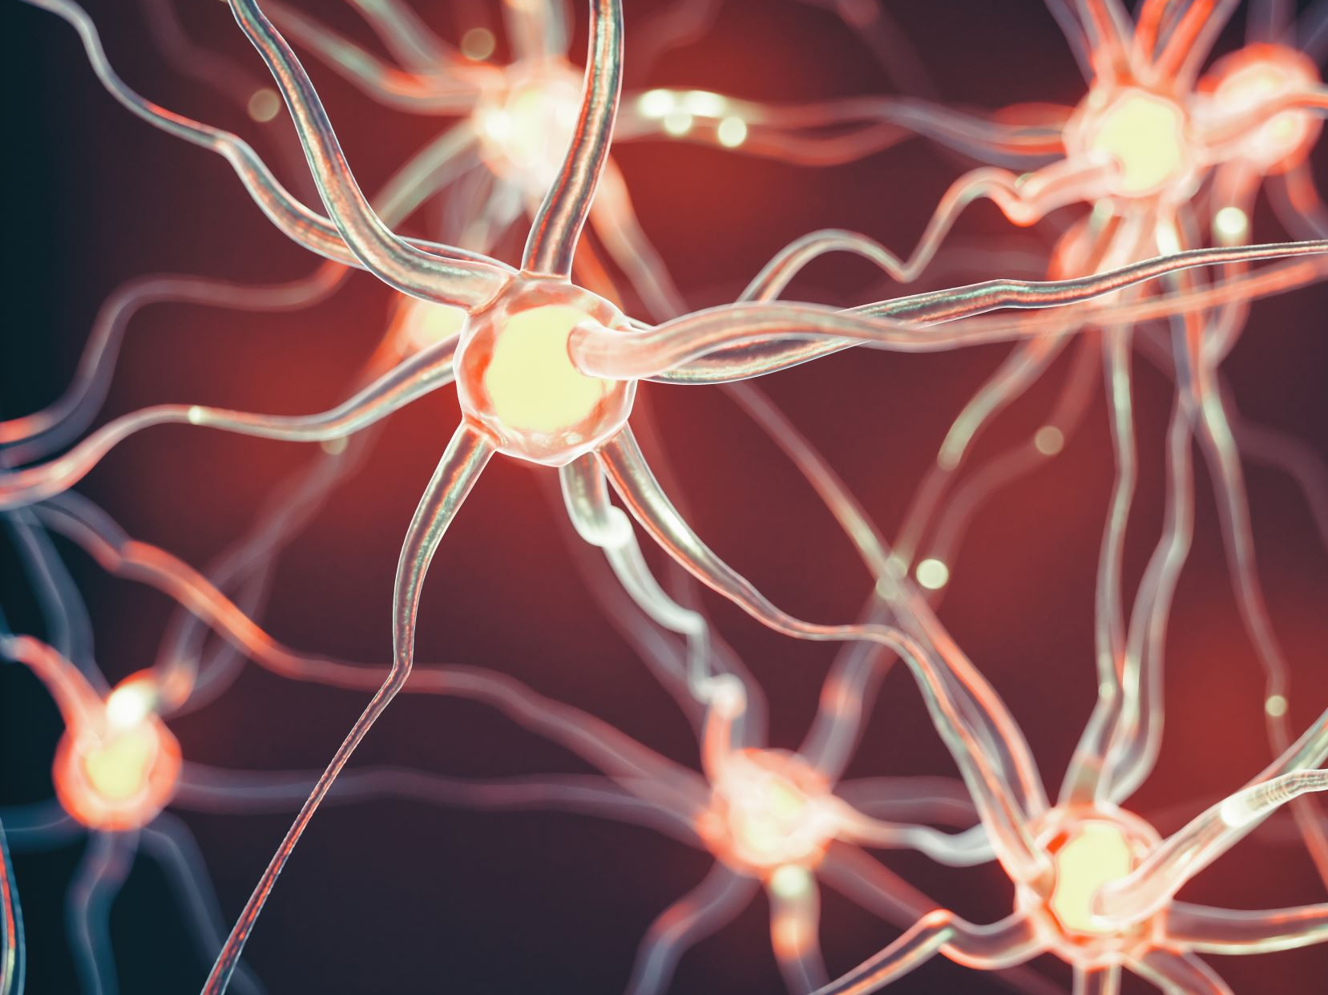
Relaxation effect of Breathing
Slowing breathing to 8 breaths/minute activates the parasympathetic nervous system, suppresses the sympathetic nervous system (Komori, 2018)
Prolonged expiratory breathing activates the parasympathetic nervous system, calming
Breathe in 4 steps
Breathe out 6 steps
Notes:
The there is a stressor, the sympathetic nervous system activates the stress response. After the stress is over, the Parasympathetic nervous system helps the body return to a state of calm. It lowers heart rate and breathing, blood pressure, and increases digestion.
Kimori’s study showed that there is a relaxation effect with a prolonged exhale, which activates the parasympathetic nervous system and suppresses the sympathetic nervous system. When you walk around later, try Breathe in 4 steps, Breathe out 6 steps. More structured programs can be found on these apps – BreathR, Calm, or Insight Timer.
_________________________________________
Komori T. (2018). The relaxation effect of prolonged expiratory breathing. Mental illness, 10(1), 7669. https://doi.org/10.4081/mi.2018.7669

Slide 23
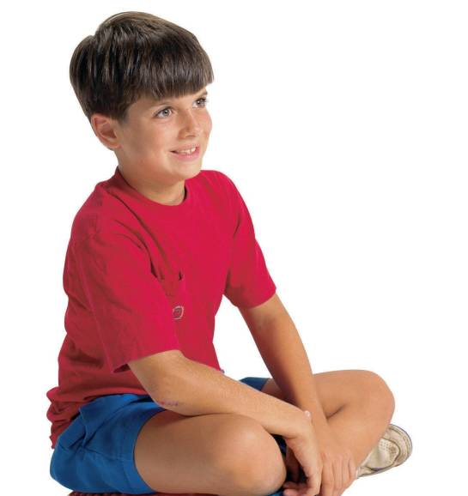
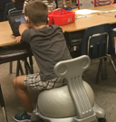
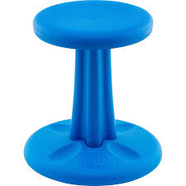
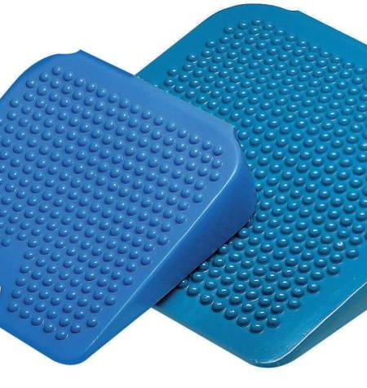
Movement Tools
Dynamic Seating (Disc O Sit, Movin’ Sit, ¼ inflate a beach ball, therapy ball, Kore stool)
Movement Breaks
Classroom Helper Jobs
Hallway Wall activities
Heavy Work
Theraband across chair legs
STAND UP
Notes:
There are many movement tools, and one of the most effective physical tools is to move our bodies. There are small movement tools and there are bigger movement tools. The small move tools may be helpful for a short period of time, but most people need bigger movements. Why does some of this work?

Slide 24
Physical Activity Evidence
Physical activity before school, 30 minutes
Parent and teacher reports improved ADHD symptoms, moodiness, and peer functioning
Easily accessible, low risk, low cost, and has potential health benefits
Regular exercise increases dopamine, serotonin, and norepinephrine
Moderate to vigorous intensity
Chronic moderate exercise can enhance brain plasticity.
Hoza et al., 2014; Lin & Kuo, 2013
Notes:
In 2014, Betsy Hoza and colleagues researched the effects of structure physical activity on attention in children grade KG to 2. The intervention was 30 minutes per day before school. Parents and teachers reported improved ADHD symptoms, moodiness and peer functioning. It is easily accessible, low risk and cost and has health benefits. Physical activity should be considered as a treatment adjunct in ADHD.
Lin & Kuo found that regular exercise increased levels of dopamine, serotonin, and norepinephrine, and we know that these are key neurotransmitters for self-regulation. The higher intensity of the physical activity was found to be more effective than lower intensity. Over time, chronic moderate exercise can enhance neural plasticity and may play a role in resistance from various medical conditions.
_____________________________________________________________________
Hoza et al. studied 202 children in grade K-2 who had ADHD symptoms and those who did not, and split them into 2 intervention groups: physical activity (PA) and Sedentary Classroom-based (SC). The PA group received continuous activity at a rate that required children to breathe hard, at a level that is also considered at a Moderate- to vigorous- intensity physical activity (MVPA) level. The SC group did art in a sedentary classroom setting. The intervention happened Mon-Fri for 31 minutes every day before school. And she measured parent and teacher’s reports of ADHD symptoms, moodiness, and peer functioning. Praise, effective instructions, stickers for participation, and short small group activities were provided to help with behavior.
What she found was a significant effect size on parent-reported outcomes. Parents noticed that PA groups had reduced ADHD symptoms and had benefits in mood for both ADHD-risk and TD children. Parents and teachers both noted that the SC and PA groups improved peer behaviours in ADHD-risk children. So, she suggested that the improvement in ADHD symptoms, mood, and peer functioning may also carryover into school and home performance. Another factor that was important was the use of structured activities, small groups, short periods of activities, and behavioural interventions in the form of positive reinforcements.
Intervention = structured program for both PA and SC
2 min. large group activity
3 x 9 min. small group stations
2 min. large group activity
Praise and effective instructions. Stickers for participation.
Hoza et al., 2014
Lin, T. W., & Kuo, Y. M. (2013). Exercise benefits brain function: the monoamine connection. Brain sciences, 3(1), 39–53. https://doi.org/10.3390/brainsci3010039

Slide 25
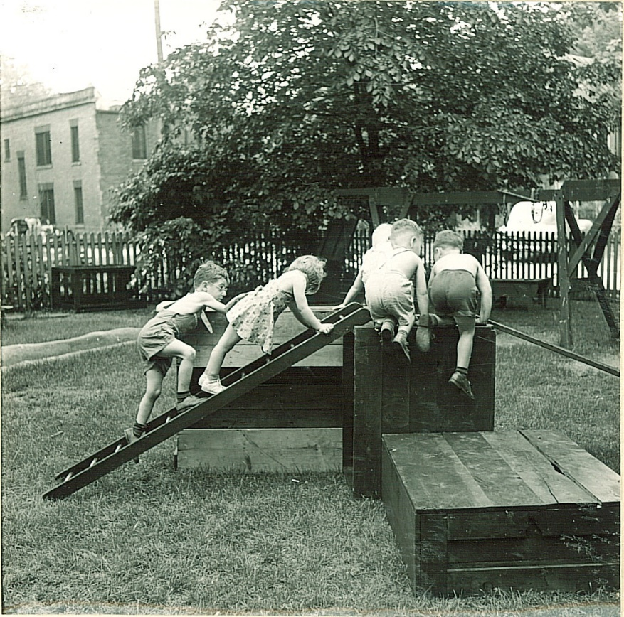
Heavy Work
Walk or Run
Climbing, Hiking, Biking
Sports
Heavy work = Push, Pull, Lift, Carry
longer lasting effect with dopamine, norepinephrine, and serotonin
Notes:
A type of physical activity called Heavy Work requires bigger muscle contractions and gives more feedback to the body and brain. Short bursts of Heavy Work can give us longer lasting effects with dopamine, norepinephrine, and serotonin. E.g. If you only have 2 minutes, doing 20-30 wall-pushes is more effective than a 2 minute gentle walk.

Slide 26
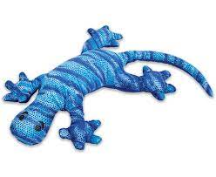

Touch Tools
Deep Pressure tools: Hugs, Massage, Leaning, Blankets
Warm, Cold
Something in your hands, Fidget tools
Lap weights – Manimos, Hugimals, weighted blanket
Notes:
Weighted animals can provide deep pressure and proprioception which is calming for the body, by releasing serotonin. Think about massage and heat for calming and other types of deep pressure such as hugs or getting wrapped up in a blanket.

Slide 27
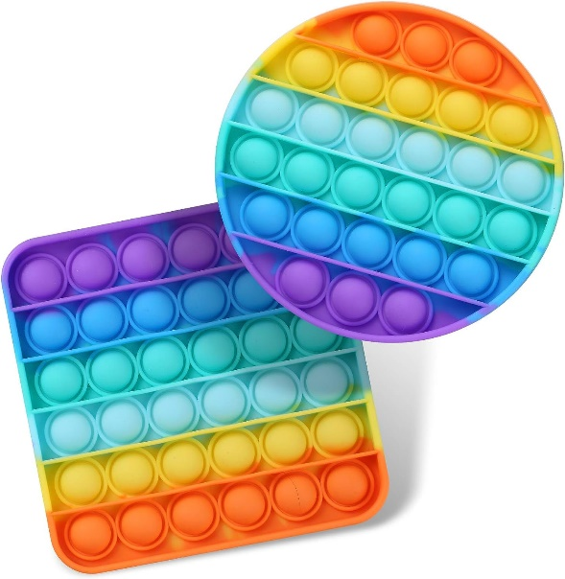
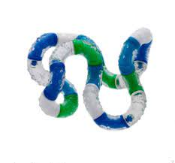
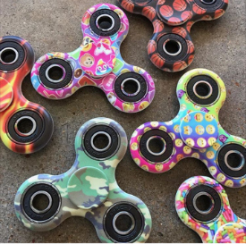
Fidgets
Tangles
Needs to be small, quiet, and have a moving part.
Are they Toys or Tools?
Notes:
Not everyone needs a fidget tool, but a little while ago EVERY KID wanted/ NEEDED one of these fidget spinners. OR did they? The other fad was these popits. Great for a little while, then …maybe not so helpful. How many of you have gone out and bought this great new fidget tool, and now you don’t even know where it is in your house? The key is having a rotating variety of fidgets that you know work for your child, so you can keep it fresh and interesting. It needs to be small, quiet, and have a moving part.
Is the fidget tool a tool or toy? If it is distracting, then it has become a toy, just like the other toys in the house.

Slide 28
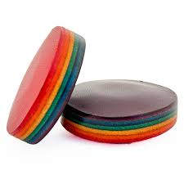



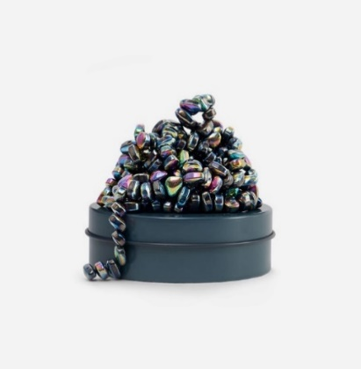

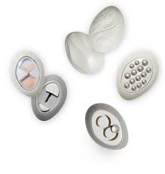

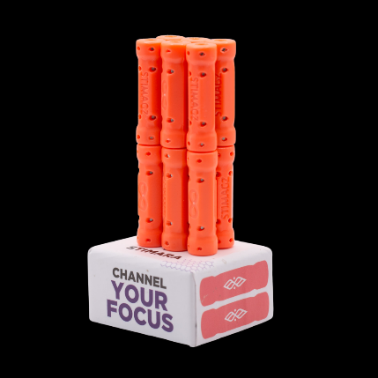

More Fidget Tools
Calm Strips
Fidget Newton
Speks
Lifelines Grounding Stones
Needoh Cubes, Slime
Doodling, Colouring
Fidget Cubes, Infinity Cubes, Rubiks cubes
Picking and tearing at objects
Fidget rings, Spin rings, bracelets
Stimagz
Notes:
Almost any item can become a fidget tool. There are endless fidget tools out there. Remember you can provide all these tools, but a child’s self-regulation and learning will need adult co-regulation, practice of the process, and support until they can be more independent with the Check Engines process. Just like giving me all the tools for me to fix my car when I have no idea what to check in the engine.

Slide 29
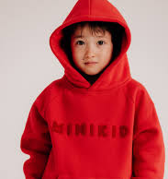
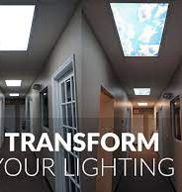
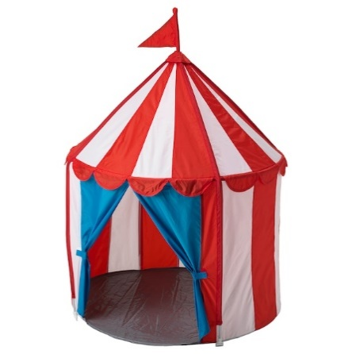
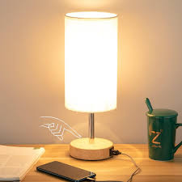
Eye Tools
  Lamps
  Blinds
  Hoodies and Hats
  Sunglasses
  Reduce visual
  Close eyes
  Leave room
  Sensory Safe space
Notes:
Environmentally, it is difficult to change the environment we are in, depending on other people in the room, options for lighting, and the space available. Some options to dim or change the colour of lighting can have a calming effect, such as table lamps, closing the blinds, wearing hoodies or hats, sunglasses, reducing the visual clutter or distractions, closing your eyes for a few seconds, leaving the room for a break, or a sensory safe space.

Slide 30
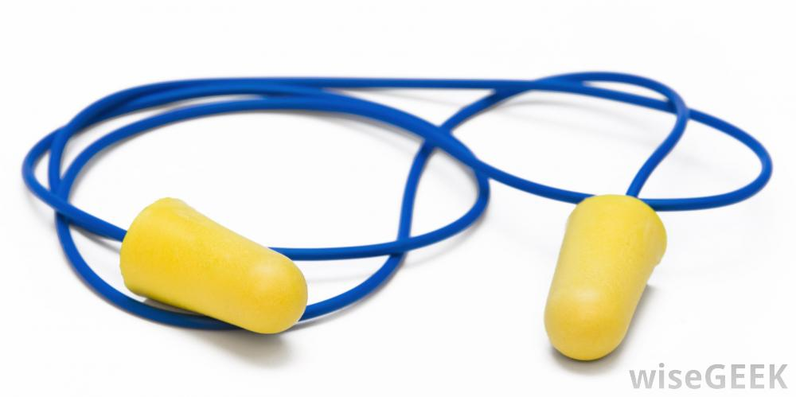
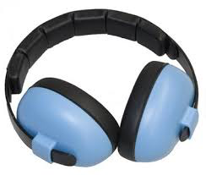
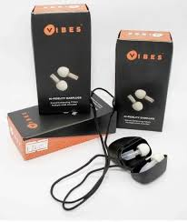
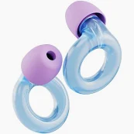
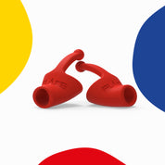
Ear Tools
Music
Silence - Ear plugs, noise cancelling
Leave room, quiet space
White noise, radio, fan, waves, wind
Noise filtering:
Loop
Flare Calmer
Vibes
Hoodies
Notes:
Hoodies are multifunctional in their ability to buffer sound or noise, block the visual, and for a physical buffer from the environment. Here are some ear tools to help with attention and focus and for those with noise sensitivities. With individual’s unique preferences, there are various ways to modify the auditory input that the ears and the nervous system are receiving, such as soft music or background white noise, silence, leaving the room for a quieter space, or noise filtering options shown here.
___________________________________
Loop Engage Kids earplugs https://us.loopearplugs.com/
Flare Calmer Kids earplugs https://www.flareaudio.com/en-ca/products/calmer-kids
Vibes earplugs https://www.discovervibes.com/

Slide 31
Natural boosters
Physical activity
Hugs, physical connection
Social Connection
Laughter
Breathing
Getting enough sleep
Eating enough protein and food
Listening to music or doing something that brings you joy
Spending time Outdoors
Notes:
Remember these evidence-based ways to naturally boost our neurotransmitters. Get physical activity, physical connection and hugs, connect socially, laugh, breathe deeply, eat and eat enough protein (protein is made up of amino acids, which is essential to help produce the neurotransmitters), Listen to music or doing something that you enjoy doing, and spend time outdoors. Research tells us that 20 minutes at a time (for an average of 2 hrs per week) helps decrease the stress hormone cortisol and has been shown to boost mood and overall health. It can be as quiet as sitting on a park bench or more active such as hiking in nature.
https://www.parkprescriptions.ca/en-ca
_________________________________________________
TABLE 14-2 Amino Acids and Their Neurotransmitter/Neuromodulator Products
Amino Acid Product
Tryptophan Serotonin Melatonin
Tyrosine/phenylalanine Dopamine Norepinephrine Epinephrine
Histidine Histamine
Arginine Nitric Oxide
Threonine (etc.) Glycine
*Melatonin is not believed to be a neurotransmitter but is a behaviorally active metabolite of tryptophan synthesized by the pineal gland. There is evidence that administration of tryptophan increases the release of melatonin in humans (Hajak et al., 1991).
(retrieved from Institute of Medicine (US) Committee on Military Nutrition Research. The Role of Protein and Amino Acids in Sustaining and Enhancing Performance. Washington (DC): National Academies Press (US); 1999. 14, Amino Acid and Protein Requirements: Cognitive Performance, Stress, and Brain Function. Available from: https://www.ncbi.nlm.nih.gov/books/NBK224629/ )

Slide 32
Key Points
Co-Regulation is key
Biological Domain is the Foundation of Self-Regulation
Sensory Motor Tools are just “things”, until you learn to use them
Engine Speeds Analogy for Internal Awareness
Biological Self-Regulation is a process of Interoception and Mindful awareness
Mouth, Move, Touch, Look, Listen, and Interoception together
Notes:
To summarize the key points of today, Co-regulation is key in self-regulation in children with ADHD, the biological domain is the foundation of self-regulation, sensory and motor tools are just things in the process and they need to be understood and used appropriately, think of the engine speeds analogy for internal awareness, and the biological self-regulation process of interoception and mindful awareness. Finally, mouth, move, touch, look, and listen tools work together with our sense of interoception for better self-regulation.

Slide 33

THANK YOU!
Notes:
Thank you so much for joining me for this presentation. Please enjoy the rest of your day.

Slide 34
REFERENCES
1. Bader A, & Adesman A. (2012). Complementary and alternative therapies for children and adolescents with ADHD. Current Opinion in Pediatrics, 24(6), 760-769. doi:10.1097/MOP.0b013e32835a1a5f
Caspersen, C. J., Powell, K. E., & Christenson, G. M. (1985). Physical activity, exercise, and physical fitness: definitions and distinctions for health-related research. Public Health Reports, 100(2), 126-131.
Creative Commons, (n.d.) online images retrieved from www.creativecommons.org
da Silva, B. S., Grevet, E. H., Silva, L. C. F., Ramos, J. K. N., Rovaris, D. L., & Bau, C. H. D. (2023). An overview on neurobiology and therapeutics of attention-deficit/hyperactivity disorder. Discover mental health, 3(1), 2. https://doi.org/10.1007/s44192-022-00030-1
Garfinkel, S. N., Seth, A. K., Barrett, A. B., Suzuki, K., & Critchley, H. D. (2015). Knowing your own heart: distinguishing interoceptive accuracy from interoceptive awareness. Biological psychology, 104, 65–74. https://doi.org/10.1016/j.biopsycho.2014.11.004
Hedgcock, W. M., Vohs, K. D., & Rao, A. R. (2012). Reducing self-control depletion effects through enhanced sensitivity to implementation: Evidence from fMRI and behavioral studies. Journal of Consumer Psychology, 22(4), 486-495. https://doi.org/10.1016/j.jcps.2012.05.008
Hirano, Y., & Onozuka, M. (2015). Chewing and attention: A positive effect on sustained attention. BioMed Research International, 2015, 1-6. doi:10.1155/2015/367026
Hoza, B., Smith, A., Shoulberg, E., Linnea, K., Dorsch, T., Blazo, J., . . . McCabe, G. (2014). A randomized trial examining the effects of aerobic physical activity on attention-deficit/hyperactivity disorder symptoms in young children. Journal of Abnormal Child Psychology, 1-13. doi:10.1007/s10802-014-9929-y
Keen, D., & Hadjikoumi, I. (2011). ADHD in children and adolescents. Clinical Evidence, 02:312
Kim, Sung-il & Reeve, Johnmarshall & Bong, Mimi. (2016). Introduction to Motivational Neuroscience. 10.1108/S0749-742320160000019022).

Slide 35
REFERENCES
Komori T. (2018). The relaxation effect of prolonged expiratory breathing. Mental illness, 10(1), 7669. https://doi.org/10.4081/mi.2018.7669
Kumar, M. A., & Swathi, G. (2024). Effectiveness of interoceptive programs to improve academic self-regulation and reduce behavioral problems among children with learning disabilities. Cureus, 16(6), e61816. https://doi.org/10.7759/cureus.61816
Mah, J.W.T., Doherty, M. (2021). Sensorimotor Intervention Group for Children with ADHD and Sensory Processing Difficulties: A Feasibility Study. Journal of Child and Family Studies, 30, 447–459. https://doi.org/10.1007/s10826-021-01900-y
Mah, J.W.T., Gill, H., & Doherty, M.(2023). Feasibility and Efficacy of the Alert Program® for Children with Attention-Deficit/Hyperactivity Disorder. Clinical Child Psychology and Psychiatry,28(3):924-936. https://doi:10.1177/13591045231162680
Mahon, A. D., Dean, R. S., McIntosh, D. E., Marjerrison, A. D., Cole, A. S., Woodruff, M. E., & Lee, M. P. (2013). Acute exercise effects on measures of attention and impulsivity in children with attention Deficit/Hyperactivity disorder. Journal of Educational and Developmental Psychology, 3(2), 65-73.
Shanker, S. (2013). Calm, alert, and learning: Classroom strategies for self-regulation. Pearson.
Shaw, P., Eckstrand, K., Sharp, W., Blumenthal, J., Lerch, J. P., Greenstein, D., Clasen, L., Evans, A., Giedd, J., & Rapoport, J. L. (2007). Attention-deficit/hyperactivity disorder is characterized by a delay in cortical maturation. Proceedings of the National Academy of Sciences of the United States of America, 104(49), 19649–19654. https://doi.org/10.1073/pnas.0707741104
Smith, A. L., Hoza, B., Linnea, K., McQuade, J. D., Tomb, M., Vaughn, A. J., . . . Hook, H. (2013). Pilot physical activity intervention reduces severity of ADHD symptoms in young children. Journal of Attention Disorders, 17(1), 70-82. doi:10.1177/1087054711417395
Shanker, S. (2013). Calm, alert, and learning: Classroom strategies for self-regulation. Pearson.
Williams, M. S., & Shellenberger, S. (1996b). How does your engine run?: A leaders guide to the alert program for self-regulation. TherapyWorks.
Williams, M.S., & Shellenberger, S. (2025). How does your engine run?"® A leader’s guide to the alert program® for self-regulation (2nd Edition, Volume 2). Albuquerque, NM: TherapyWorks, Inc.

