Slide 1
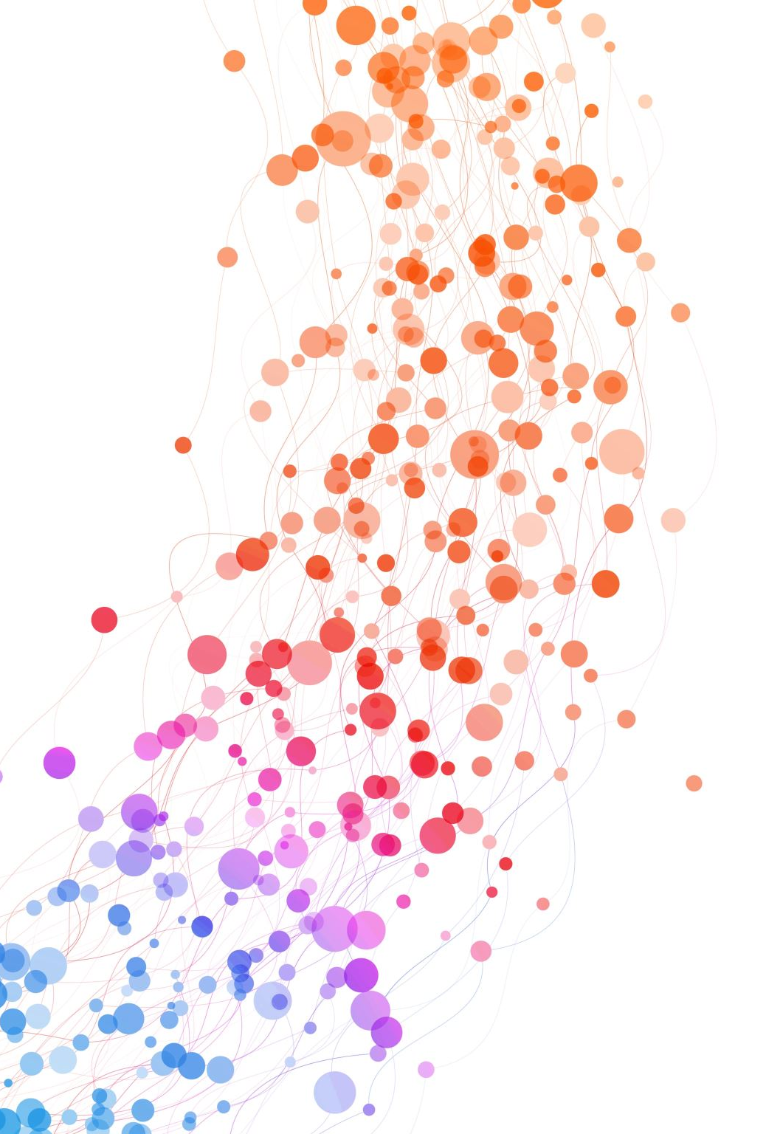
Mental Health Literacy
Community of Practice Update
February 2024

Slide 2
Community:
A feeling of fellowship with others, as a result of sharing common attitudes, interests, and goals.
Practice:
The actual application or use of an idea, belief, or method, as opposed to theories relating to it.
Notes:
Connie

Slide 3
Who are we?
We are a group of educators from across British Columbia who are passionate about mental health and social emotional learning. We have created a space where we can come together and share our learning journey about Mental Health Literacy across school and Districts in BC.
Our current steering committee includes: Drew Williams and Leah Samson (SD 72) , Connie Easton (SD38),Monique Moore (SD 60) and Alex Inglis. (SD 73) and Wendy Carr (UBC).

Slide 4
Why have we created this space?
The BC Mental Health in Schools Strategy (MHSS) identifies key components and priorities for mental health promotion in schools. The BC Mental Health Literacy Community of Practice (MHL-COP) focuses on two aspects of the strategy.
From the MHSS:
CAPACITY BUILDING - Providing the school system with the tools and supports to build capacity for mental health in schools.
MENTAL HEALTH LITERACY is the knowledge and understanding of how to develop and maintain mental well-being; identify risk factors and signs of mental health challenges; access help when needed; and reduce stigma around the topic of mental health.

Slide 5
Who can join us?
Educators from across BC who would like to learn and share about mental health literacy and mental health promotion in a school, district, university, community agency or family-focused organization are welcome to join us.

Slide 6
What is the goal?
Create opportunities to learn about emerging trends, practices and the latest research,
Promote evidence-based approaches to mental health,
Strengthen the tools & resources to embed mental health and wellbeing into classrooms,
Develop a common language and understanding to improve mental health literacy and reduce stigma.

Slide 7
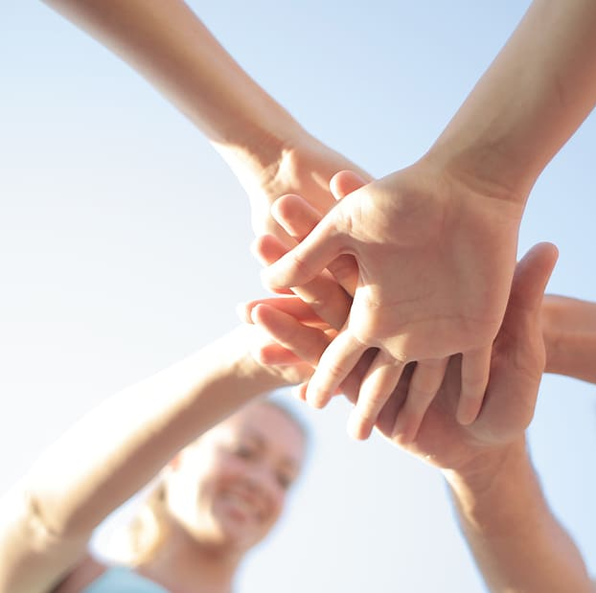
How do we gather?
We meet online throughout the school year to share, collaborate, teach, learn.
Guest presenters are invited from across the province to share their work in mental health literacy.
We then go deeper in smaller break-out groups and share what is happening in your district while learning from others.

Slide 8
When?
The MHL-CoP currently meets 3-4 times a school year to explore topics of interest generated by members. Meetings are typically from 3:30-4:30 pm via Zoom.
Our next meeting will be on Wednesday, March 6th at 3:30 on Zoom. We will have Andrew Baxter sharing information about the new Elementary Mental Health Literacy Resource. Andrew currently serves as the Team Lead for Team Mental Health.org and the Alberta Mental Health Literacy Project.

Slide 9
Get in touch!
We’d love to hear from you…
mhl.educ@ubc.ca.

Slide 10
Questions?

